Slide 1


Slide 2
Welcome to the
Mueller Family
McDonald’s Team!
Day 1: Orientation

Slide 3
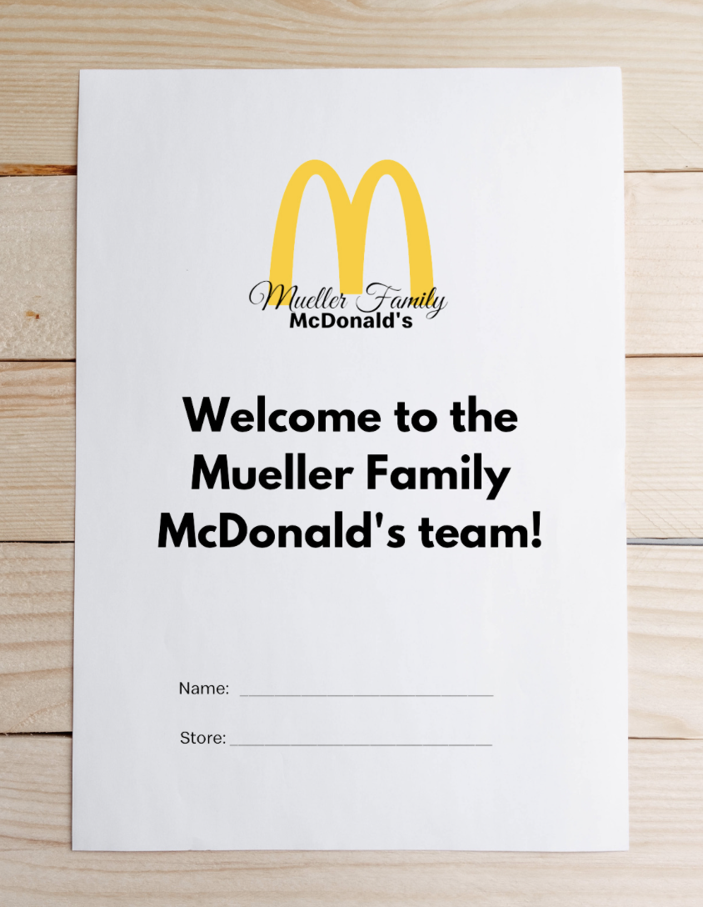
Have you:
Completed all online onboarding forms & received your orientation packet?
Verified your ID/Social Security/Working Papers
If you have not done either of these, we must reschedule your orientation.

Slide 4
Orientation Ground Rules:
Camera must be on during orientation
You will be paid for your time + one hour for completing the online onboarding
Participation is necessary in order to begin working in your restaurant!
Please stay on mute until it is time to participate to avoid disrupting

Slide 5
Let’s get to know each other!

Slide 6
Unmute your line & tell us:
Name
Store
Favorite McDonald’s Menu Item
Do you have past experience?

Slide 7
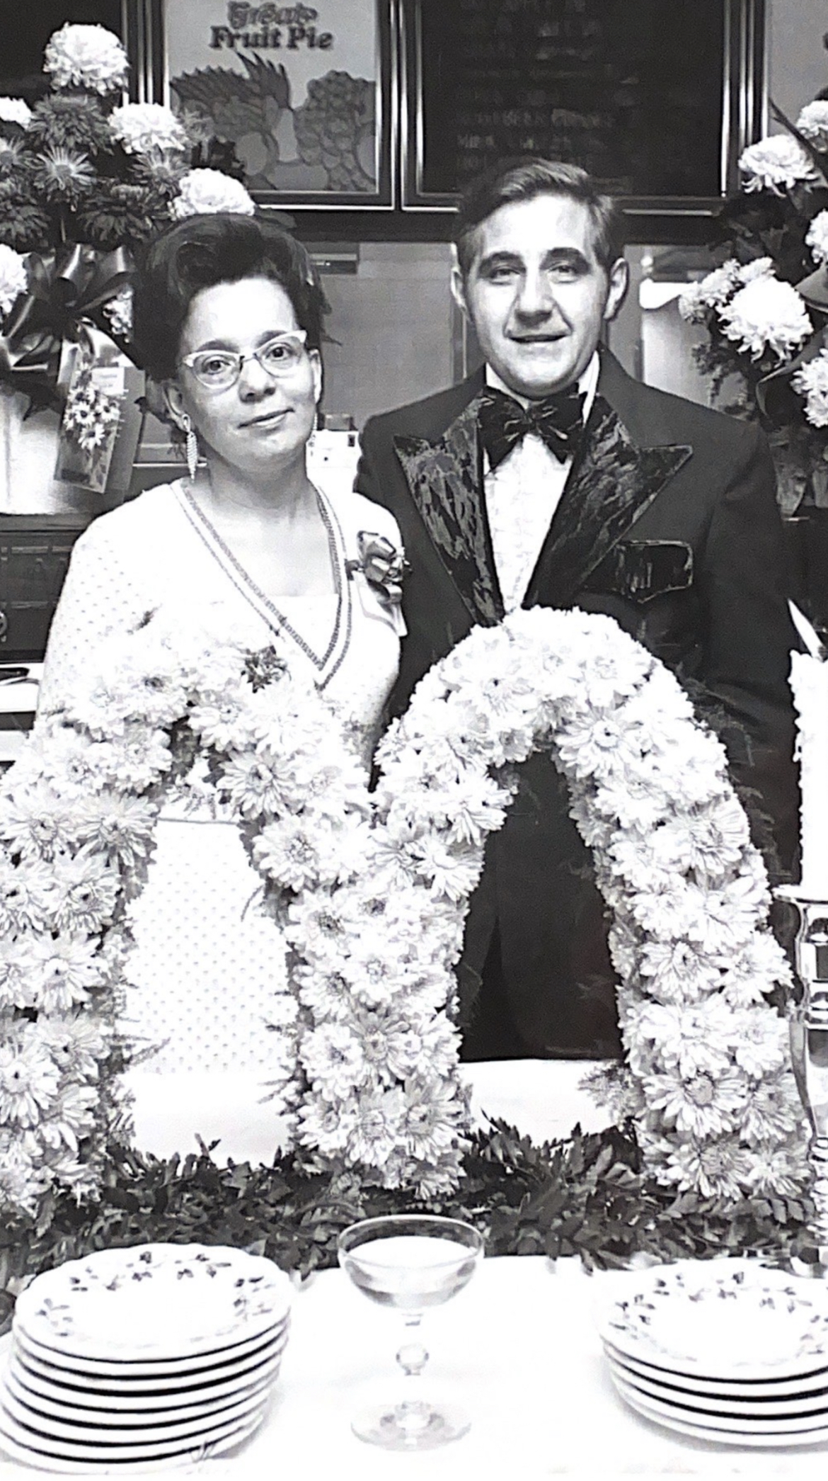
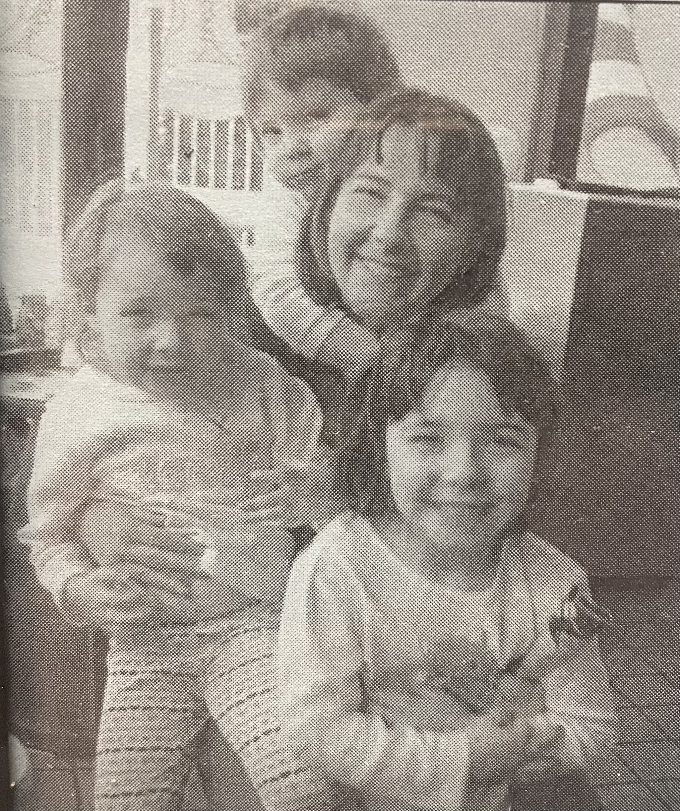
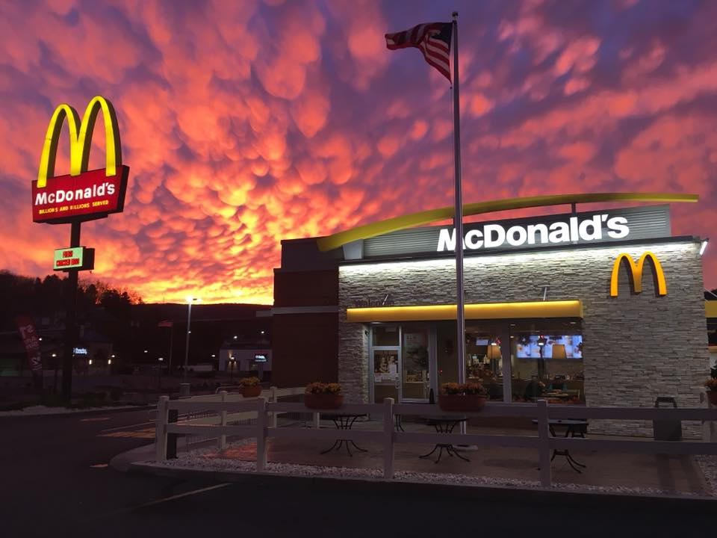
1972
2002
Today
On May 24, 1972, Mr. and Mrs. Mueller opened the South Scranton location!
Christina purchases her first location – Carbondale – and joins the family business!
The Mueller family owns and operates 19 restaurants in PA.

Slide 8
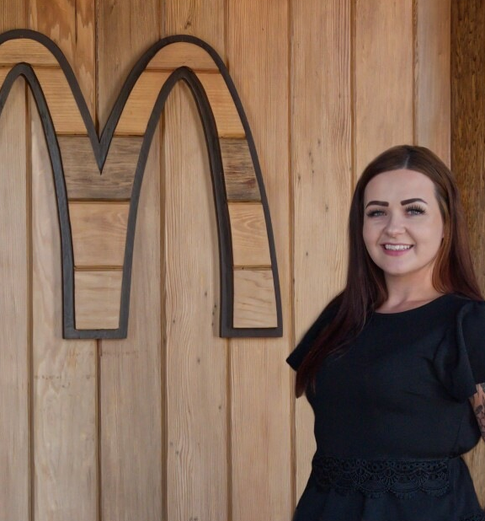
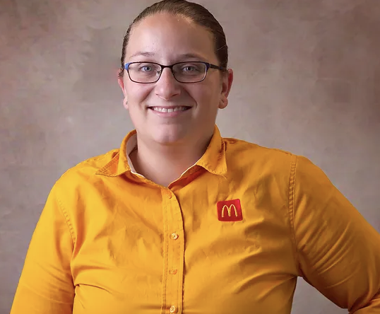
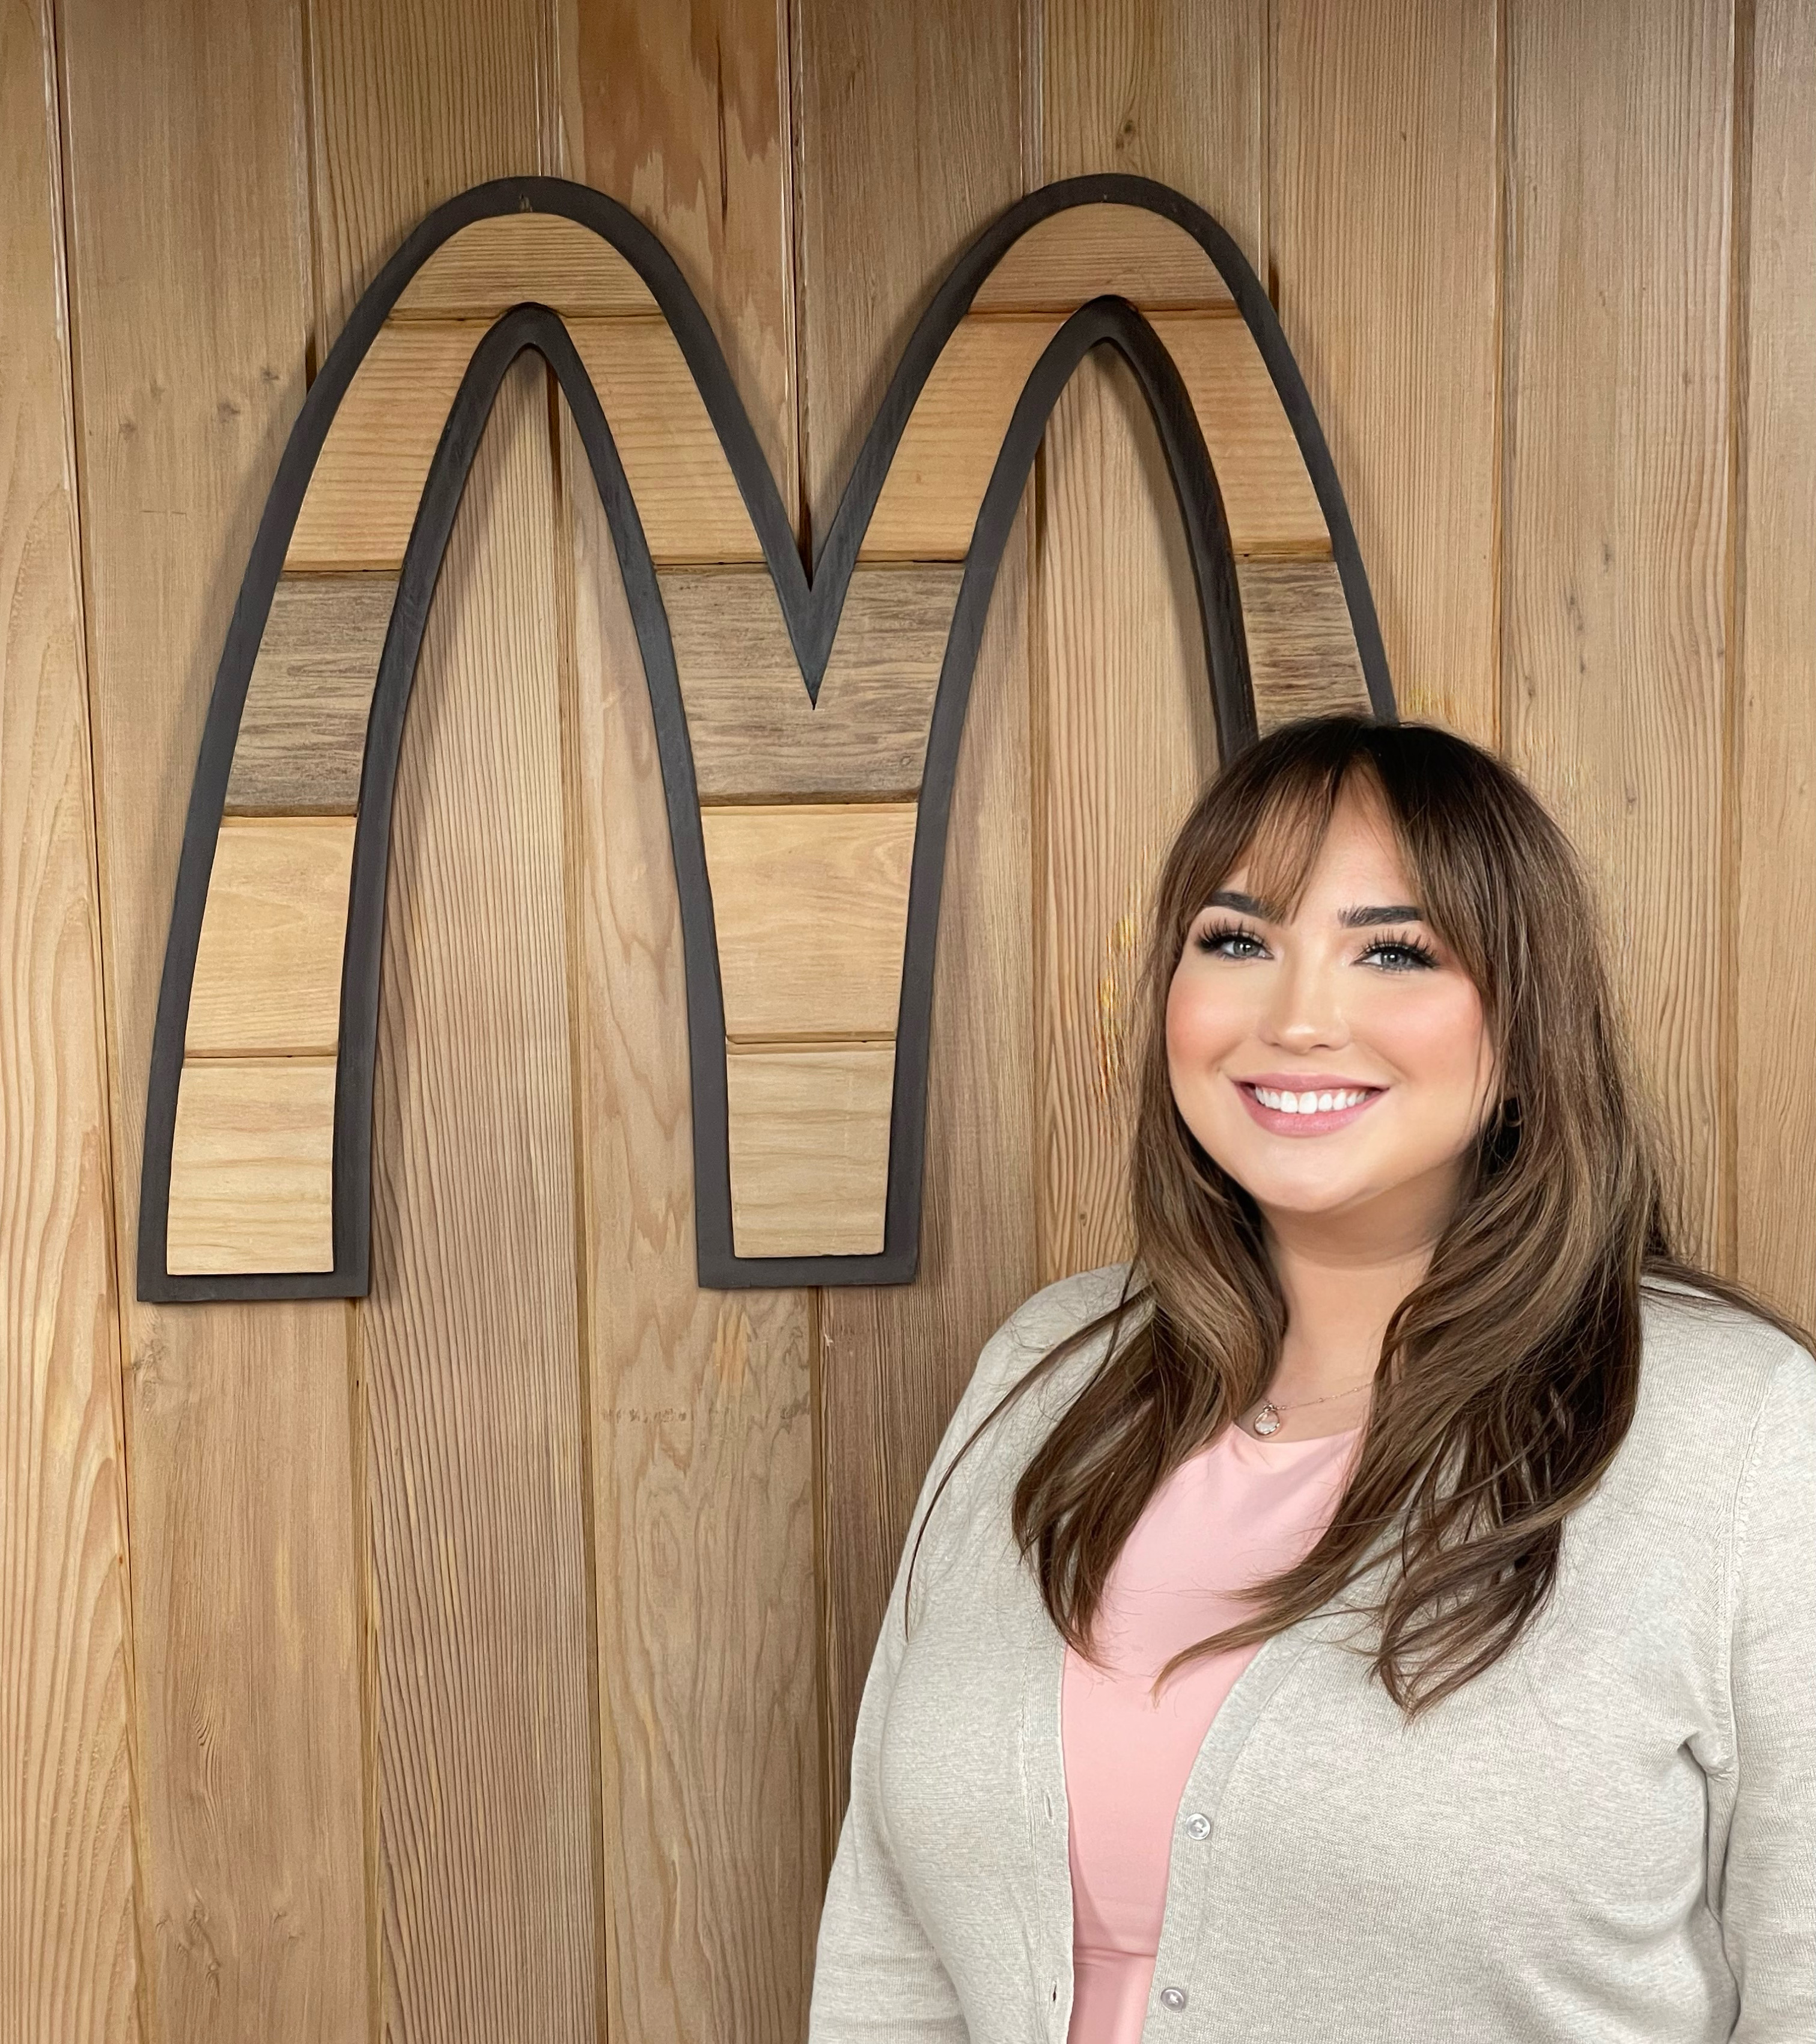
Meet our Office Staff
Lisa Merritt
Admin Staff & Hospitality Lead
office@muellermcd.com
570-586-2255 ext 3
Melissa Andrews
Office Manager
office@muellermcd.com
570-586-2255 ext 7
Taylor Noldy
Human Resources/Marketing
taylor@muellermcd.com
570-586-2255 ext 5

Slide 9
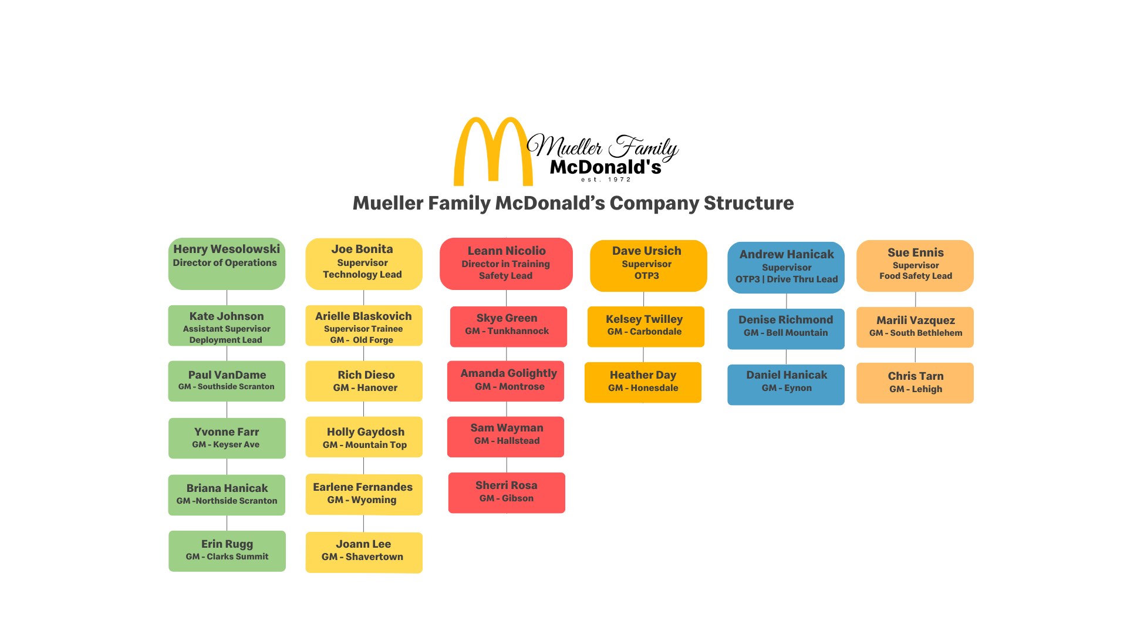

Slide 10
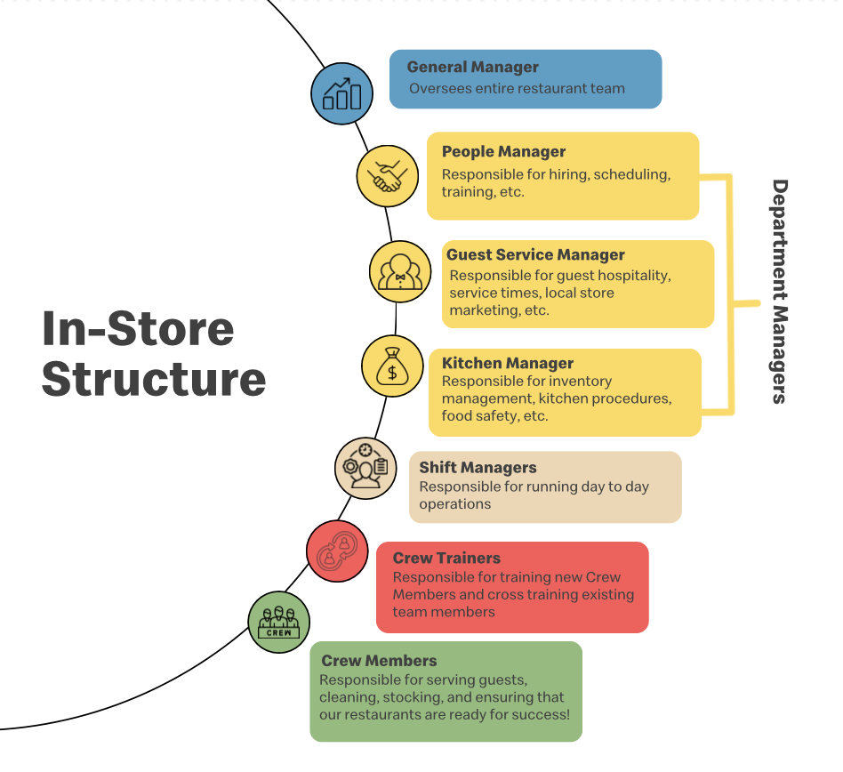

Slide 11






Serve |  | Inclusion |  | Integrity |  | Family |  | Community
We put our customers and our people first. |  | We open our doors to everyone. |  | We do the right thing, every time, no matter who is or isn’t watching. |  | We work better together. |  | We add value to our communities.

Slide 12
Employee Experience

Slide 13
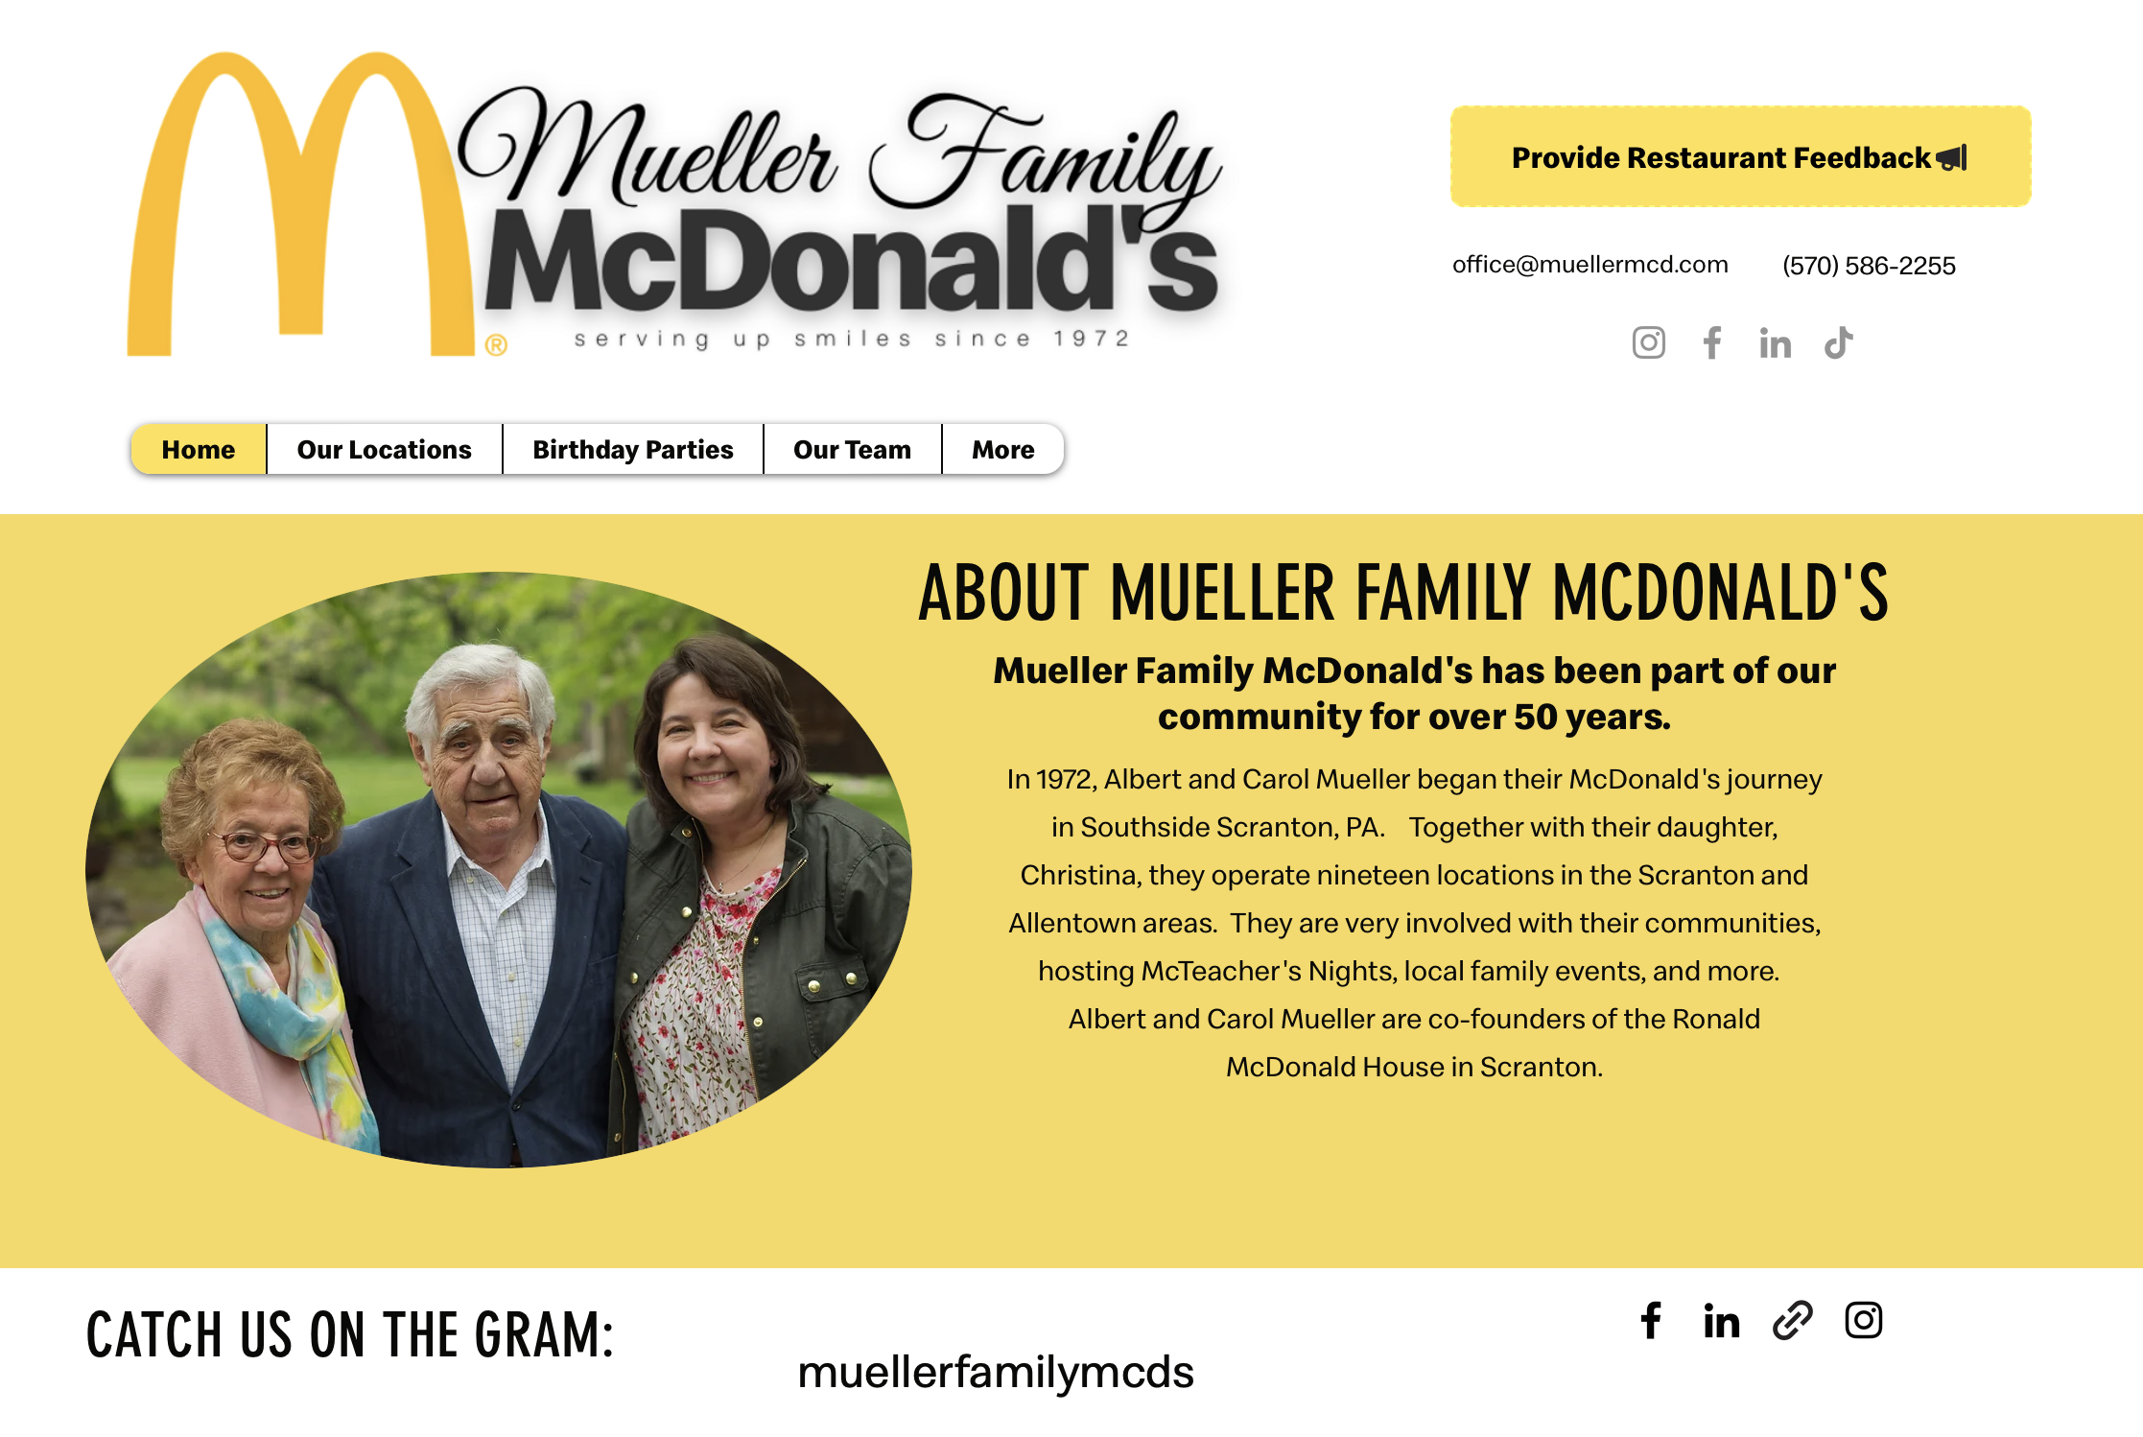
If you’re looking for more information about our company…
Our Employee Portal is the best place to find all the information you need!
Bookmark our website:
http://muellermcd.com/employees

Slide 14
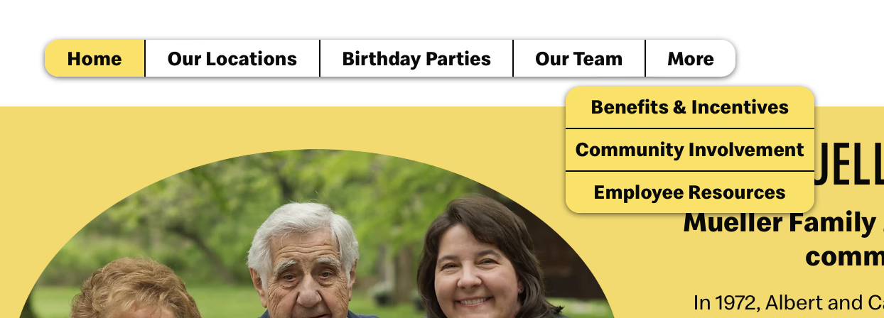
Navigate by clicking More > Employee Resources

Slide 15
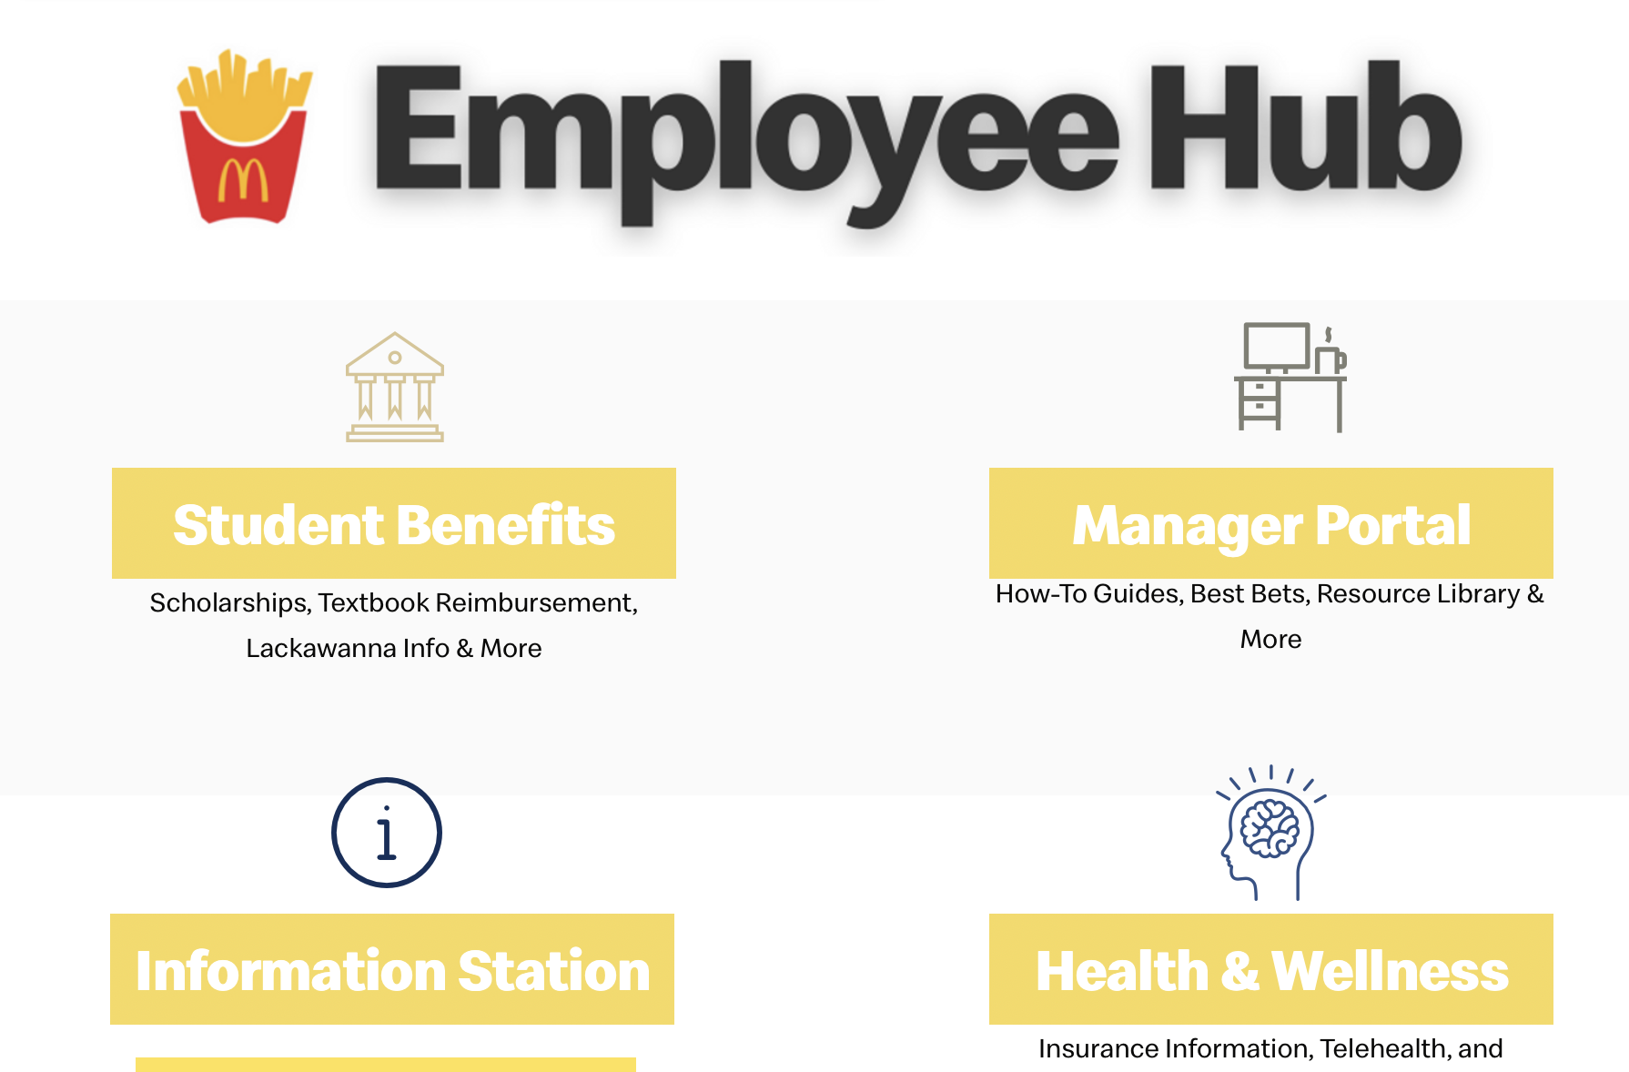

Slide 16
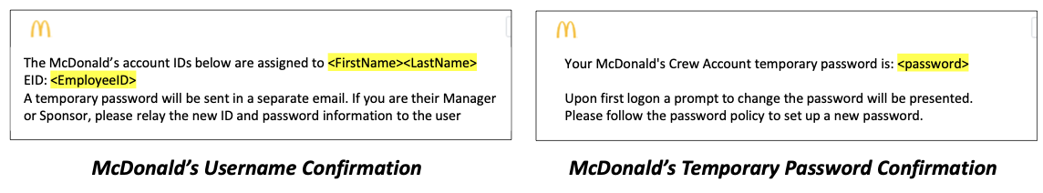
Your Employee Account
1
Check your email!
2
Congratulations!
You will receive two confirmation messages through the email (from: McDonald’s Account Management) and/or optional text phone number (from: +1 (989) 623-1955) to the contact information provided during onboarding.
Save these for your first day of work as you will need them to log into the many systems available to crew!
Bring your McDonald’s ID and password to your first day of work. You will need these to log into the many systems available to crew.
Try logging into Global Account Manager account.mcd.com
to validate your account is in working order.
Upon your first login, you will be asked to set a new password.
Contact your manager for questions.

Slide 17
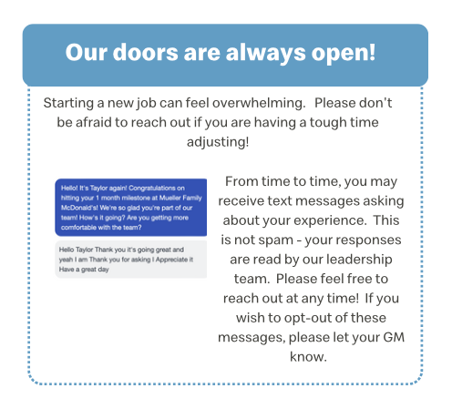
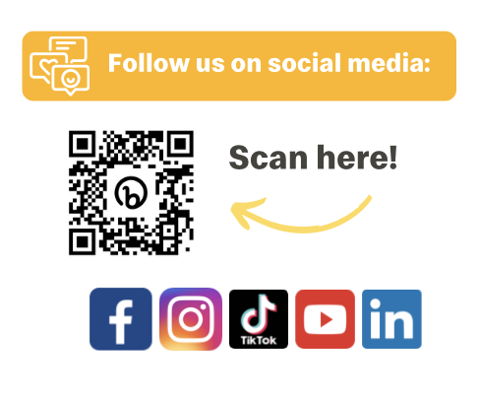

Slide 18
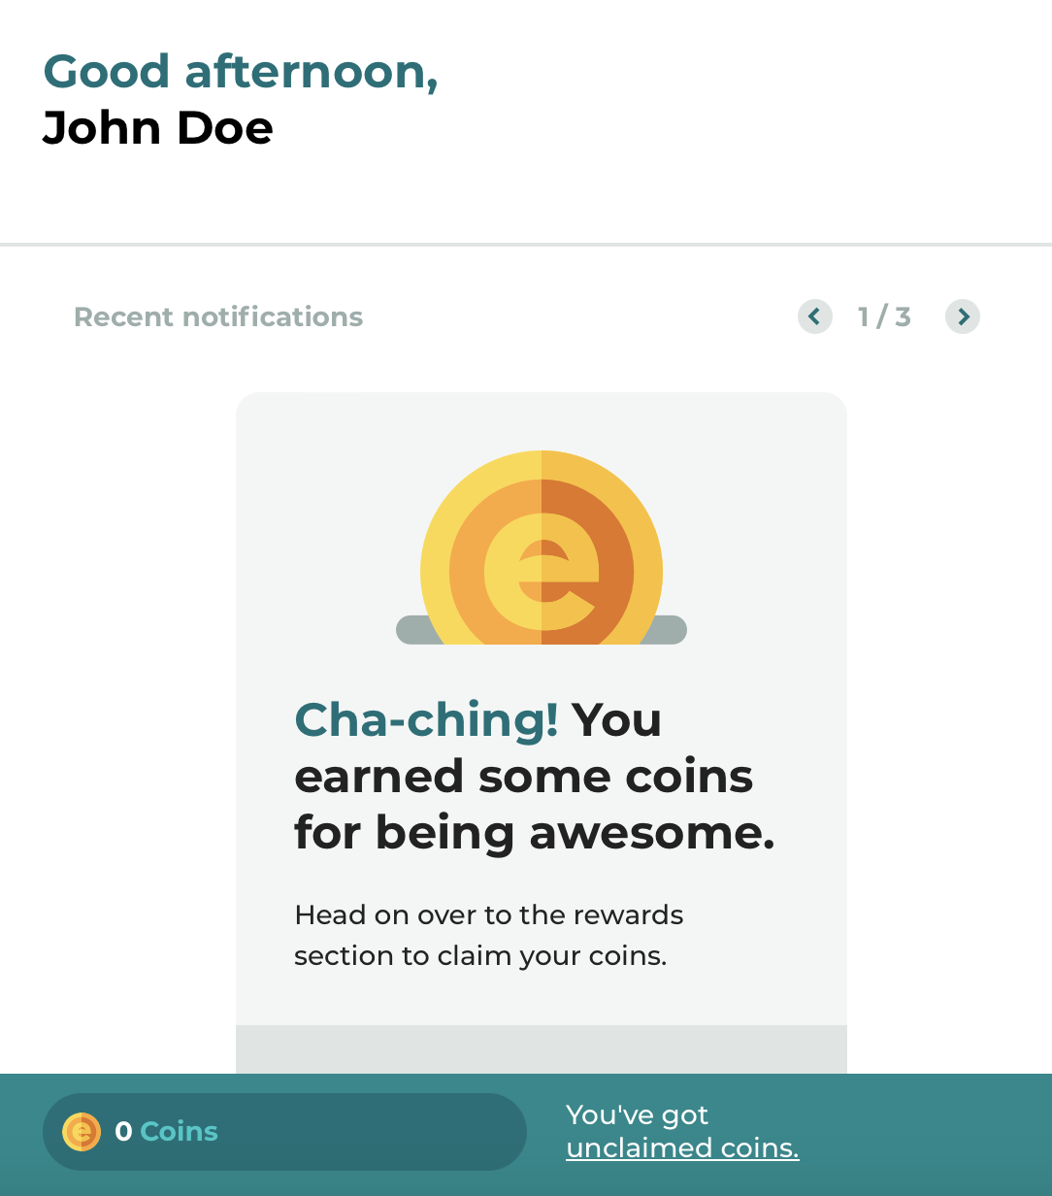

Elate App
Check your schedule, request shift coverage, and earn coins for doing a great job!
Go to www.getelate.com to download the app (it’s hidden from the App Store)
Click “Create New Account”
Enter the email address associated with your Crew Account

Slide 19
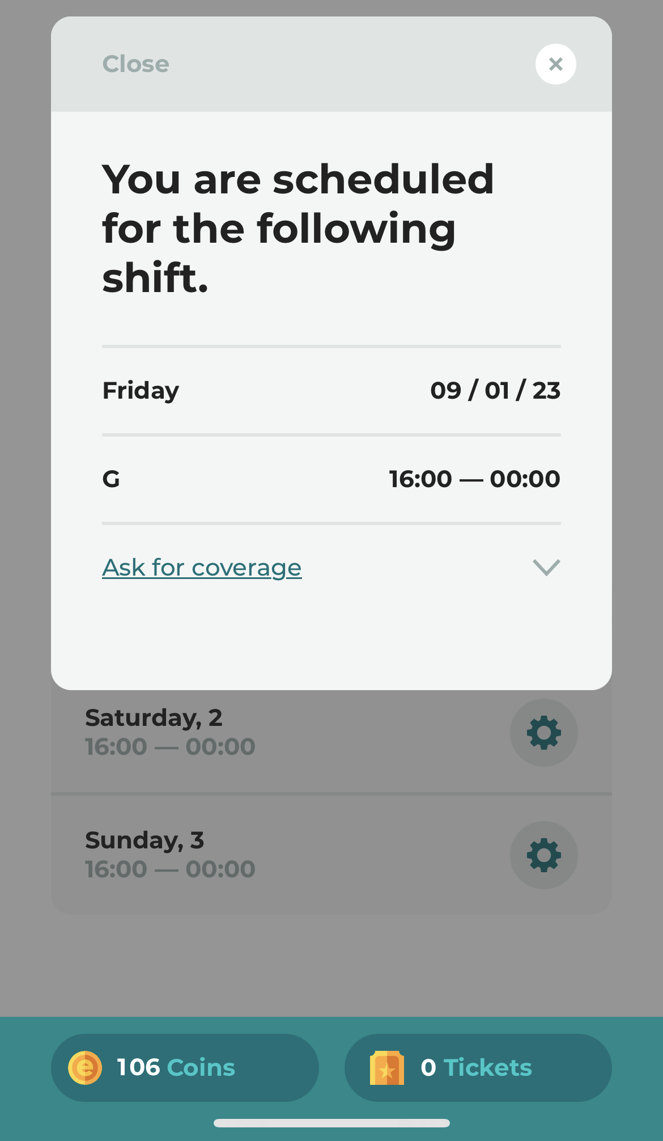
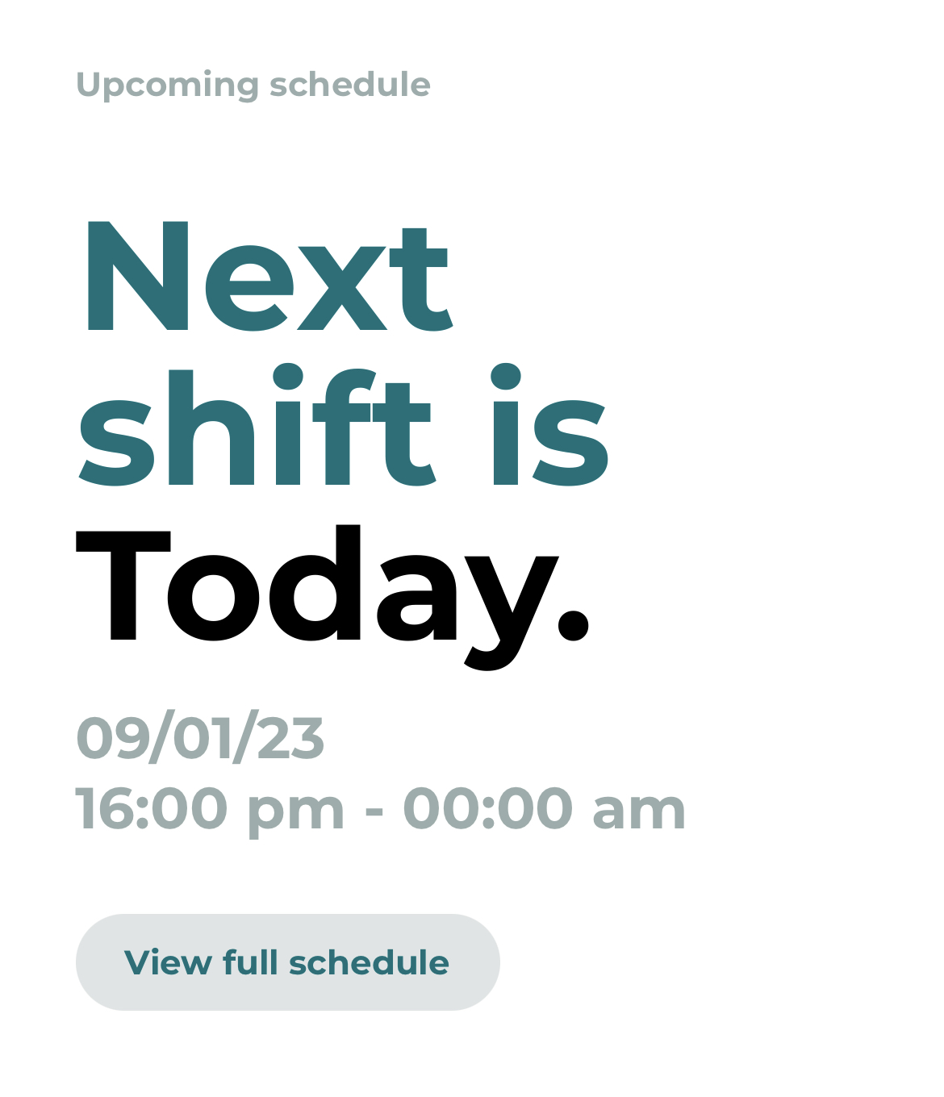
Using Elate
Find your next scheduled shift on the main screen of the app. To see your whole schedule, click the gray button.
Click any of your shifts to see more details or to request coverage.

Slide 20
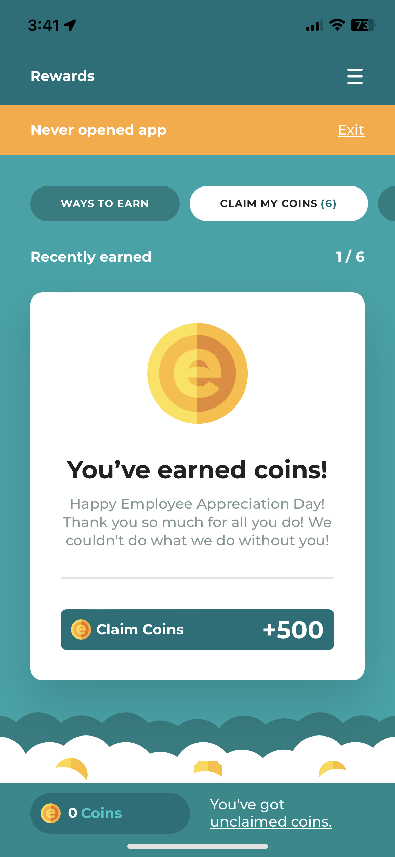
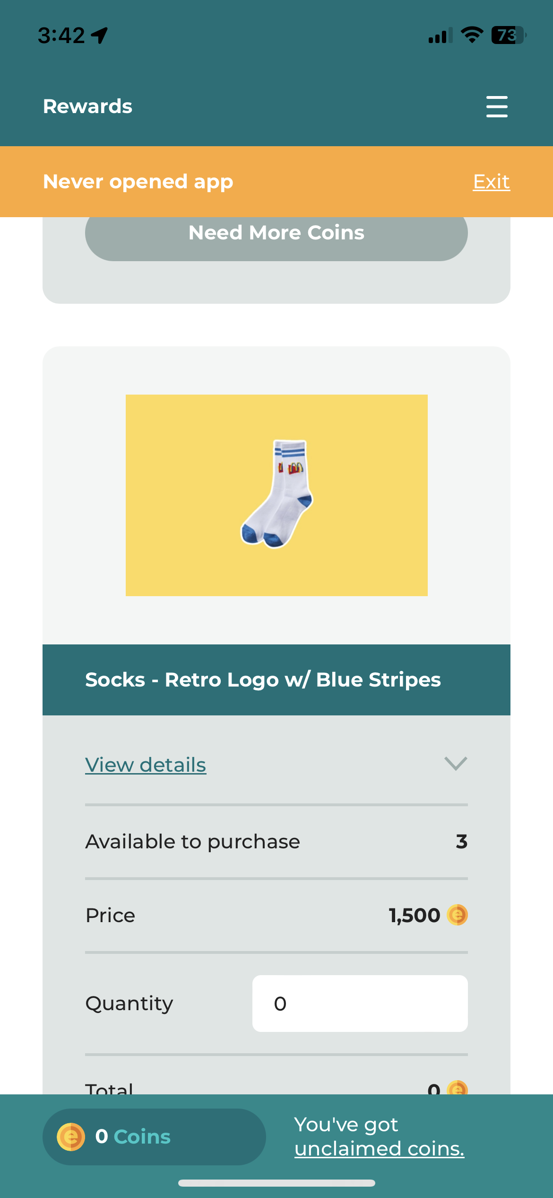
Claim coins that you earn through going above and beyond on your shifts, employee incentives, and having great attendance!
Use your coins to buy swag, enter raffles, and more!

Slide 21

Communicate through Workplace
Scan the QR codes below OR search for Workplace and Workplace Chat

Slide 22
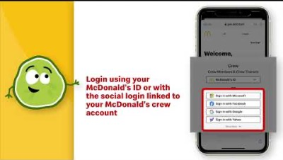
Communicate through Workplace
Our custom URL is: mcdmuellerfamily.workplace.com

Slide 23
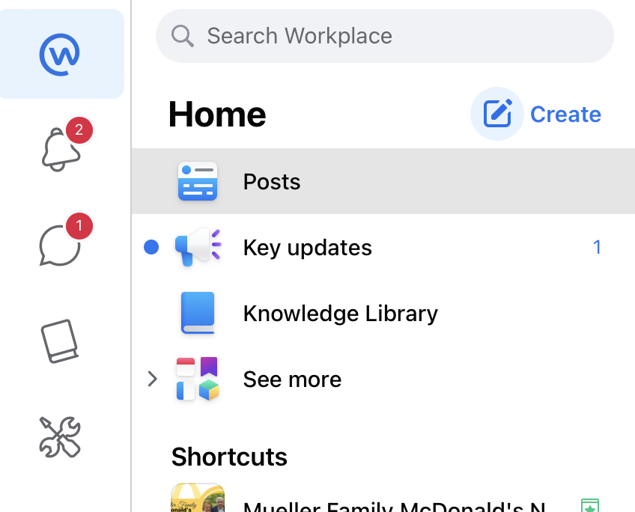
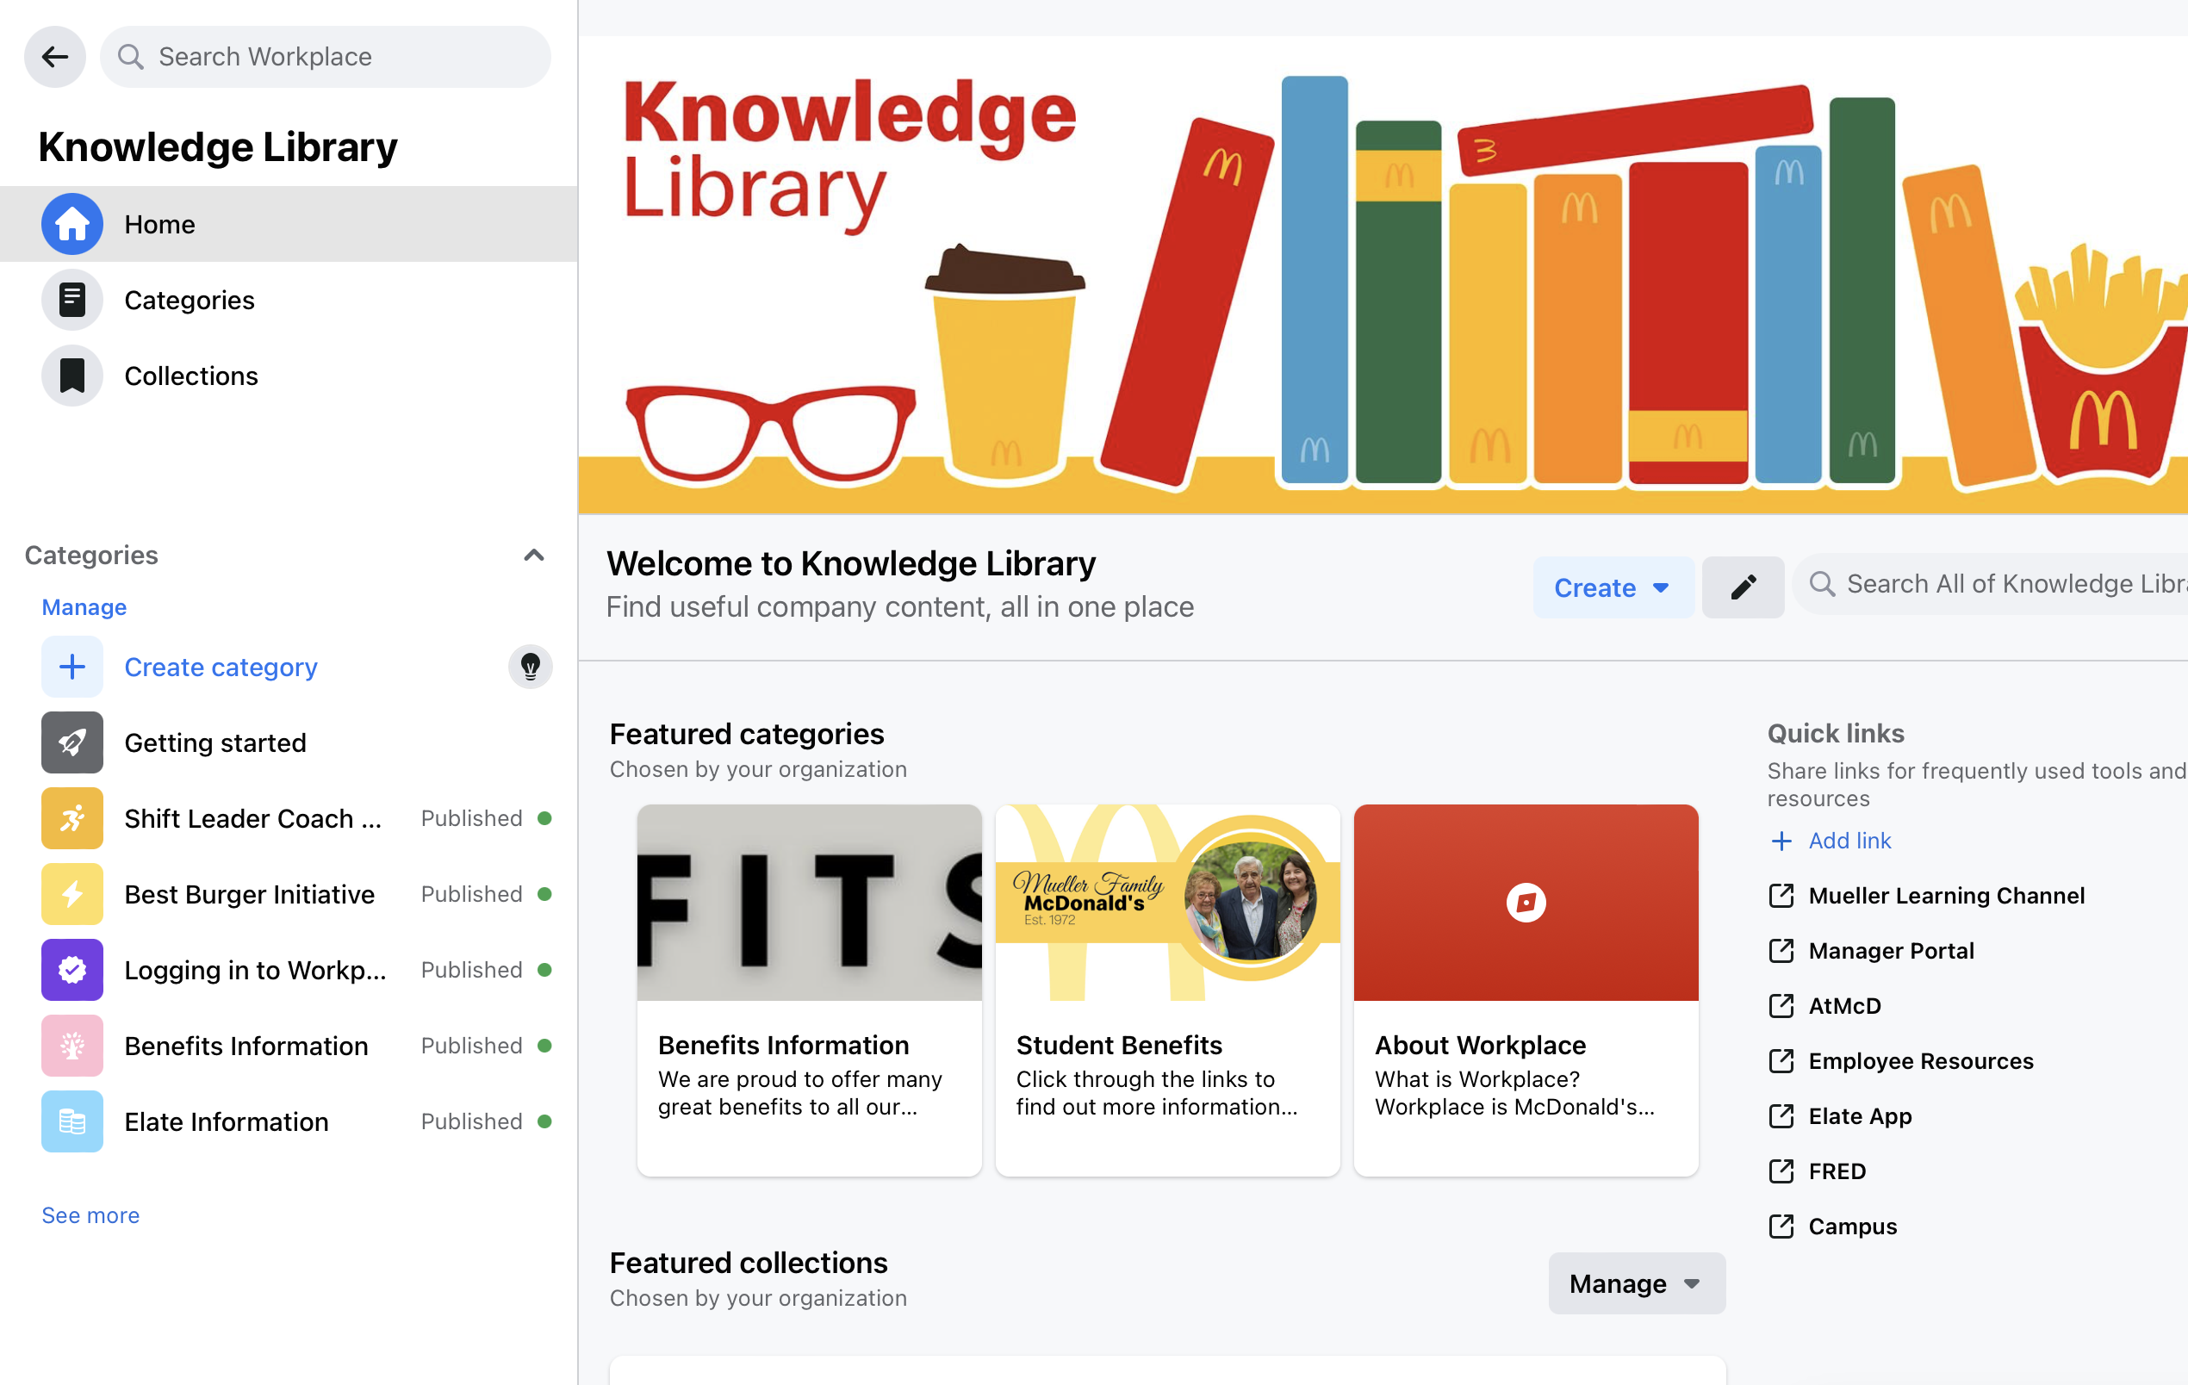
Communicate through Workplace

Slide 24
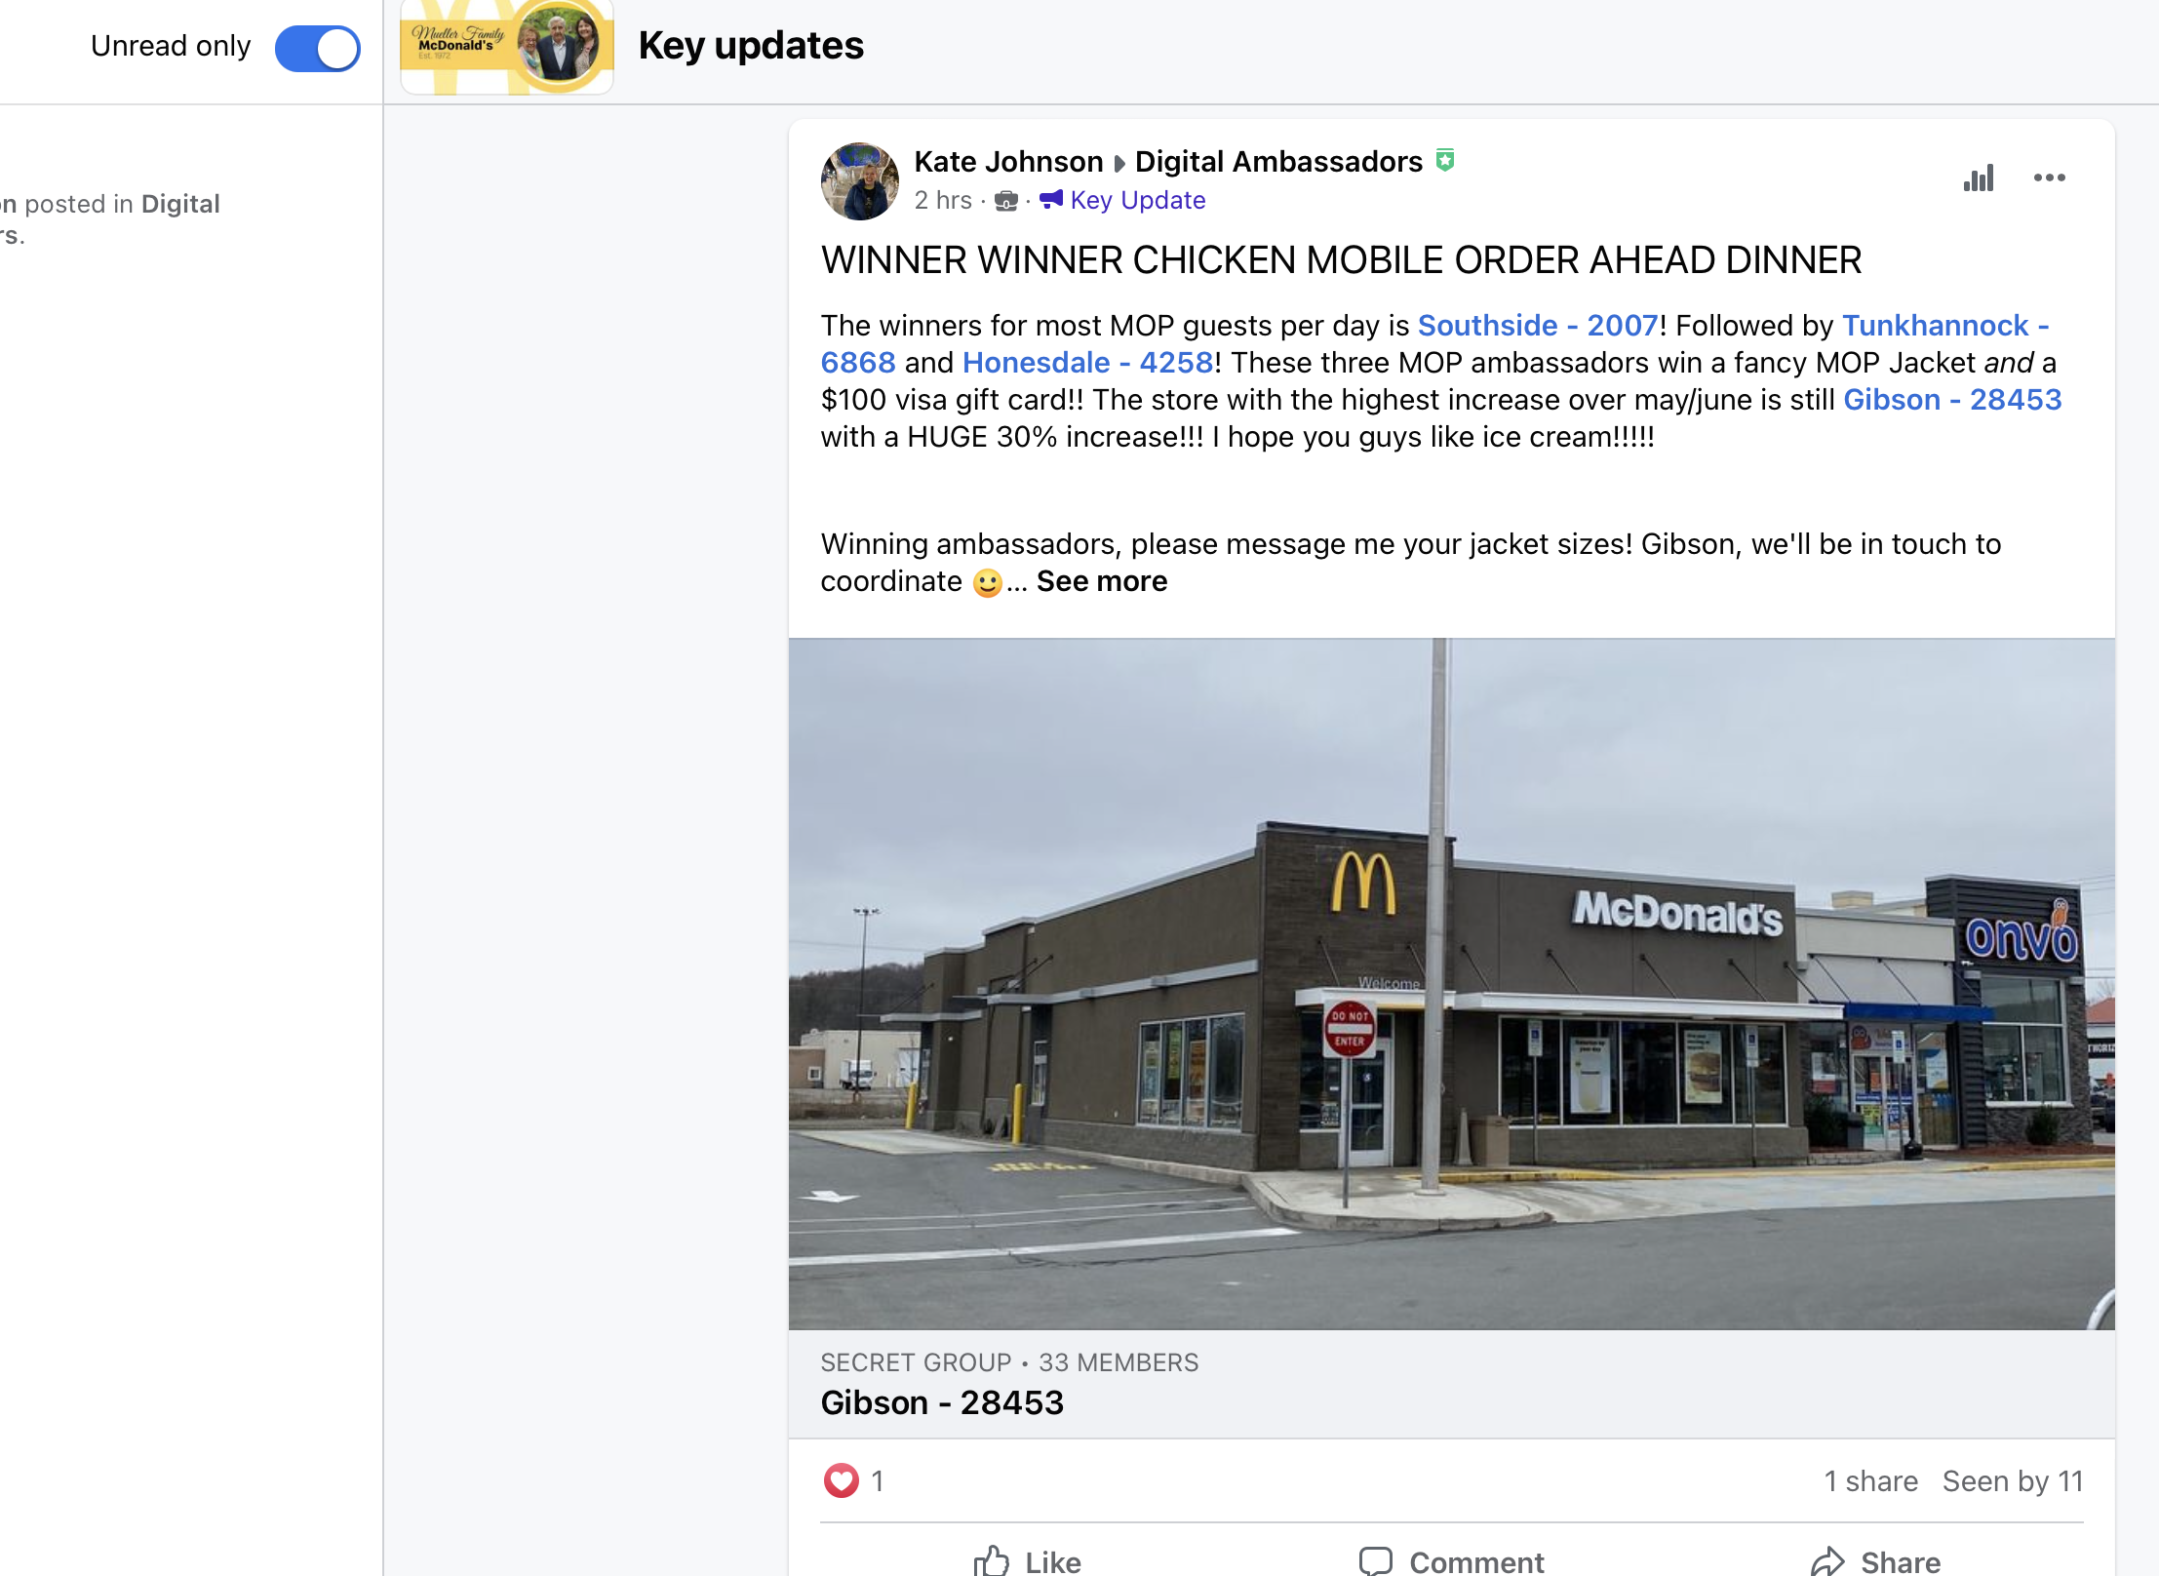
Communicate through Workplace

Slide 25
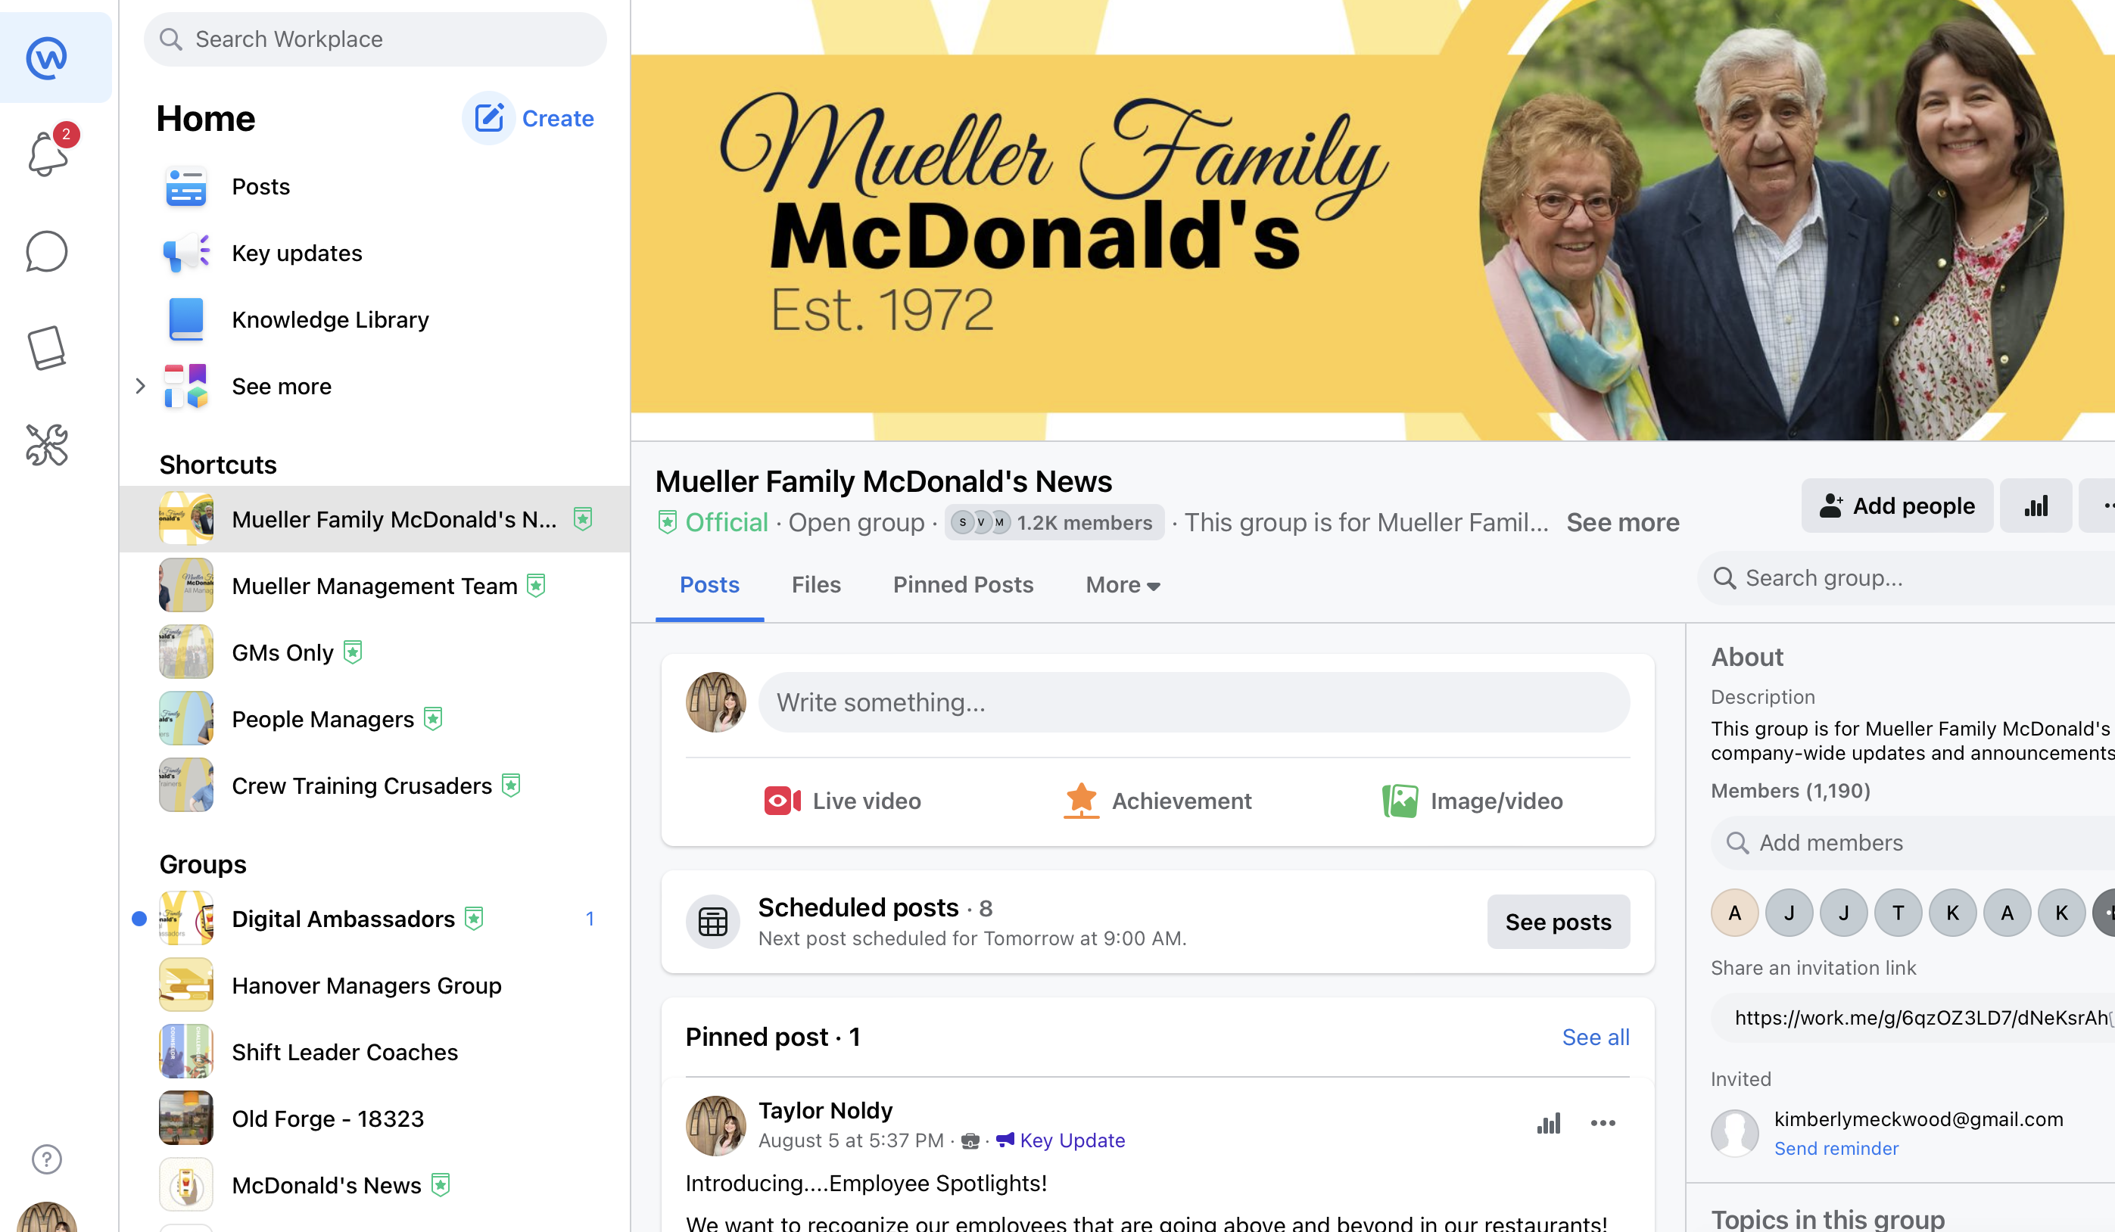
Communicate through Workplace

Slide 26
Getting Paid

Slide 27



Pay Information
Clocking In
Pay Day
Appreciation Bonus
All employees are responsible for clocking in and out for shifts.
All training time must be paid!
Pay day is biweekly on Fridays. You can pick up your pay check at the restaurant after 2 PM. If you have direct deposit, you will receive a pay stub on that Friday.
All employees are eligible for a $2 hourly appreciation bonus that resets every pay period.

Slide 28
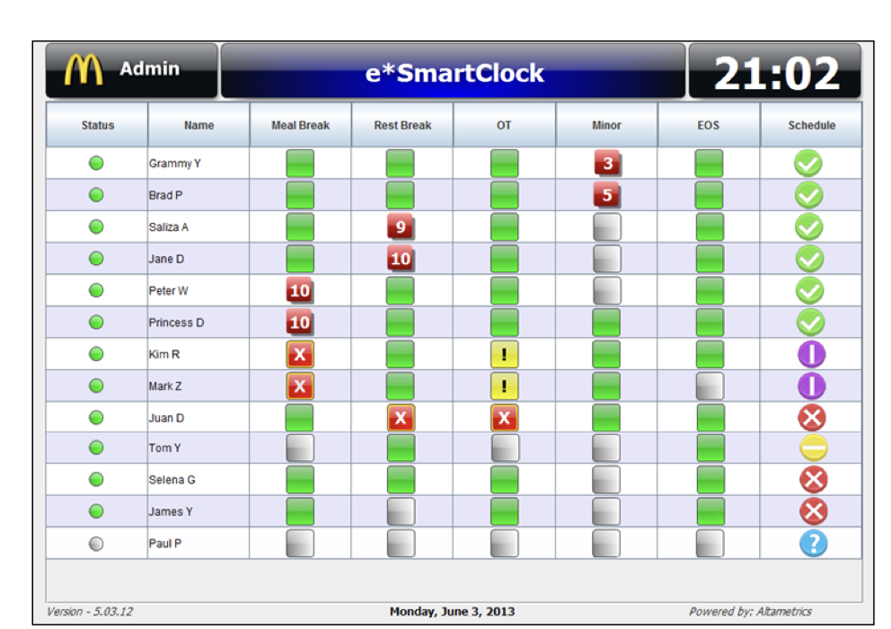
Using the Time Clock
Employee’s hours are tracked using a Smart Clock
On your first day, you will enter your finger print to punch in and out
It’s extremely important that you remember to punch in and out for all shifts and breaks!
If you forget, let a manager know immediately so it can be fixed.
Changes to your time punches must be approved by you – you will receive an alert on the clock the next time you punch in to approve.
If you do not approve of the change, do not click on the screen! Let a manager know immediately.

Slide 29
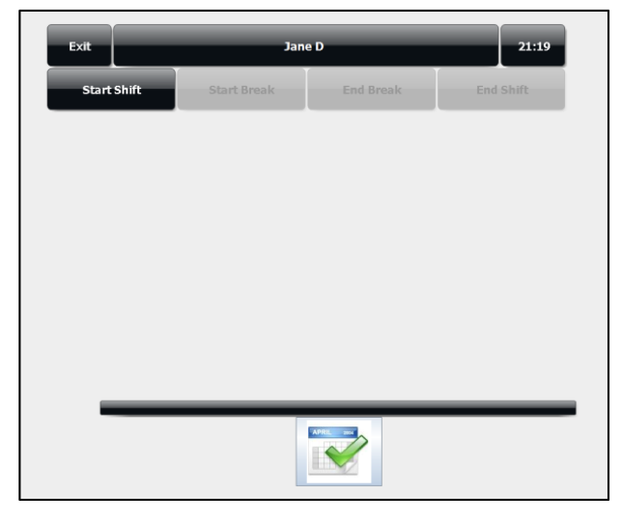
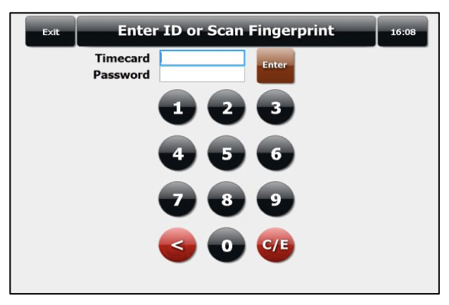
Using the Time Clock
Confirm it’s you!
Choose the right option!

Slide 30
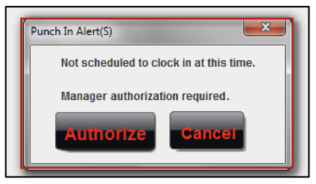
Using the Time Clock
From time to time, you may see this alert!
Read the alert carefully - you’ll need a manager to approve your punch in.

Slide 31
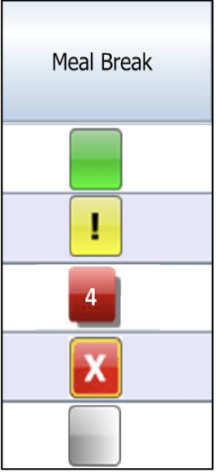
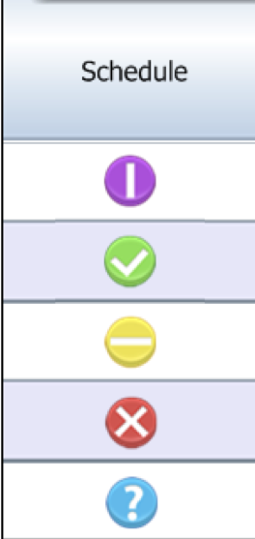
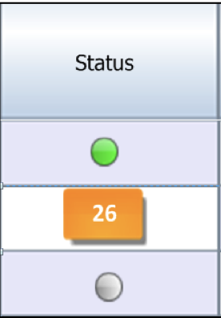
Using the Time Clock
Each column may display symbols from time to time – these are visual aids to help managers run shifts better!
If you see green, you’re good to go!
If you see yellow, you’re cutting it close on taking your break or punching in/out on time!
If you see red, you may have missed an expected time punch!

Slide 32
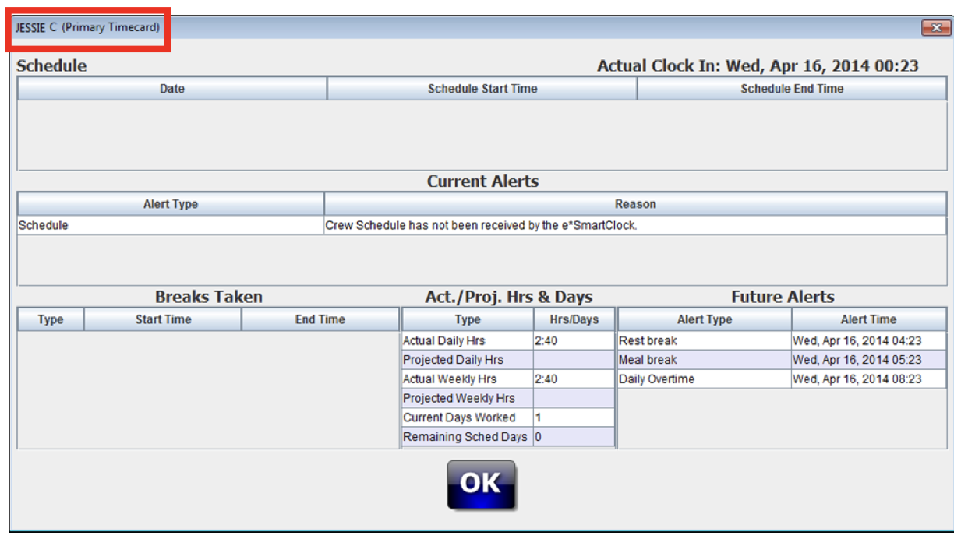
Using the Time Clock
You can review your current time punches, schedule, and projected hours right on the clock.
Find your name on the list of currently punched employees, tap it, and enter your fingerprint to pull up this screen.

Slide 33

Pay Periods
Pay periods run on a biweekly basis, Monday through Sunday.
Every store does not get paid on the same day, so your pay date may be different from someone at a neighboring store!
You can find your store’s specific pay schedule on our website on the Employee Resources page.
If you miss work, doctor’s excuses must be submitted before the end of the pay period to receive your appreciation pay. The only exception to this rule is if your absence falls on the Saturday or Sunday of the end of the pay period. In this case, you have until the following Wednesday to return your excuse.

Slide 34

Online Pay Stubs
To review your pay stubs online, you can visit payentry.com or download the Pay Entry app from the App Store or Play Store.
Click Sign In and click “Forgot Password”
Use the email address associated with your Crew Account
If you do not receive an email with a temporary password, it is possible that your online account was not yet activated.
You can activate your account using the online form on our website

Slide 35
Understanding Your Pay Stub
Verify that your name and address are correct – if not, call our office!
Base Pay Rate: Your rate NOT including the $2 appreciation pay
Confirm pay period dates here
Gross Pay (pay before taxes/deductions) Note: Overtime, Vacation/PTO, and Appreciation Pay are recorded on separate lines!
Shows your Net Pay (after taxes/deductions)
Taxes:
Check your PTO and vacation balance here
Insurance + 401k:
If you elected for direct deposit, this is what went into your account

Slide 36
Employee Benefits

Slide 37



Benefit Information
Insurance
Employees who work at least 30 hours a week are eligible for health insurance after 30 days of employment. After this, open enrollment period begins in September with coverage beginning October 1 each year.
401K
All employees age 21+ that have worked 1,000 hours are eligible for our 401k plan. We company match 100% of the first 3% of your contributions and 50% of contributions up to 5%.
Paid Time Off
For every 100 hours worked, you will earn 1 hour of PTO. You start accumulating PTO on your first day of work, and you will be able to use it starting in January of the following year. PTO must be approved by your manager to use. It is forfeited upon termination of employment.

Slide 38



Benefit Information
Vacation
All full time employees are eligible for one week of paid vacation after one year of employment. Members of the management team are eligible for additional vacation time.
Telehealth
We offer low cost ($15/month) telehealth that covers you and up to 7 members of your household to provide access to a 24/7/365 doctor. This benefit includes mental health!
Birthday PTO
The year you become eligible to use PTO, you are also eligible for birthday PTO. This is automatically paid the check immediately following your birthday, whether you used it or did not.

Slide 39



Benefit Information
Textbook Reimbursement
After 1 year, employees are eligible to receive reimbursement for textbooks purchased. Visit our Student Benefits section of our website to review specific rates and to upload your receipts.
30% National Discount
All employees are eligible for a 30% discount on food at any participating McDonald’s in the country. Access this discount by downloading the McDonald’s app and signing in with your email associated with your Crew Account.
Holiday Pay
We pay time and a half on most major holidays – Easter, 4th of July, Thanksgiving, Christmas Day, and New Year’s Day.

Slide 40



Benefit Information
Career Online High School
After 90 days, employees are eligible to complete their High School Diploma (not a GED) for free through the Archways to Opportunity Program. Contact taylor@muellermcd.com for help signing up.
Scholarships
We have multiple scholarship opportunities available including free tuition at Lackawanna College! All scholarship information is listed on our website under the Student Benefits section.
English Under the Arches
Several times a year, McDonald’s offers free English As a Second Language classes for our employees to help break down language barriers that make it challenging to work shifts.

Slide 41



Benefit Information
Student Advising
All employees and their immediate family members are eligible to use the Archways to Opportunity free student advising services to help make decisions about their educational future! Contact taylor@muellermcd.com to get set up!
Years of Service Awards
We award additional PTO to celebrate Years of Service Milestones!
Career Growth
Our company offers many options for career growth, including planned Growth Days and succession plannings between HR and our management team. If you are interested in growing, be sure to let your manager know.

Slide 42



Employee Meals
Sandwich | Side | Beverage
1 Sandwich/Entrée Item
1 Side Dish
1 Beverage
If you are working more than 5 hours, your total dollar amount must be $10.00 or less.
If you are working under 5 hours, your total dollar amount must be $7.00 or less.

Slide 43

Help Me Succeed

Slide 44

Our Expectations
We believe everyone has the opportunity to be a great member of our team.
Be On Time Make every effort to arrive on time for your shift. When you don’t, other team members have to cover for you. Be Flexible Every day is different. Some days, we may need you to fill-in for another crew member or train you on a station you haven’t worked before. You can learn something important every day. Be Polite Be courteous to others. |  | Be Respectful Treat everyone with respect and kindness. Follow the platinum rule – treat others the way they want to be treated. Be Responsible Every single job is important. Be Clean and Neat The way you look tells people you care about yourself and about them. The same goes for the restaurant!

Slide 45
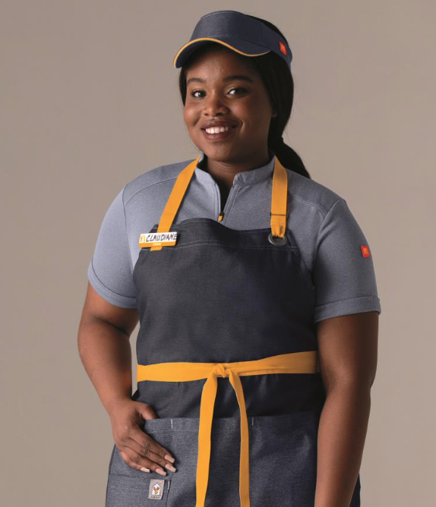
Uniform Policy
McDonald’s issued shirt
McDonald’s issued pants
Hat or Visor
Belt
Apron
Black non-slip shoes
No hoodies
Jackets/Sweatshirts must be McDonald’s issued
Long sleeve black, white, or gray shirts may be worn under uniform
T-Shirts during promotional periods only

Slide 46
Grooming Standards
Regular bathing and use of deodorant
Faces must be clean shaven or beard guard worn
Hair past the chin must be secured in a braid, bun, or ponytail (if too short for bun or braid)
Tattoos larger than a business card must be covered by provided tattoo sleeves
Facial piercings must be removed – small nose studs only
Earrings shouldn’t exceed size of dime
No watches/bracelets/rings in kitchen area

Slide 47

Safety and Security
Illness or Injury | Chemical Safety | Food Safety | Working Safely
Must be reported to a manager immediately – benefits could be delayed or denied if you wait too long! | Don’t mix chemicals and only use McDonald’s approved chemicals for cleaning. Chemicals must be stored away from food. Need ingredients? Ask your manager for the MSDS sheets on their iPad! | It is McDonald’s policy that regardless of what position you’ll be working in, you are trained on Food Safety. Food Safety is EVERYONE’s top priority! | Wear proper PPE for task: face shield for filtering, gloves, non-skid shoes, etc. Keep floors clean to avoid slips and falls or trip hazards. Report unsafe conditions to manager immediately. Evacuation plans are posted in Crew Room in the event of an emergency! In the event of a robbery, give the thief what they want – cash is replaceable, you’re not! Try to remember any details you can of the person’s appearance.

Slide 48
If you’re sick:
Stay HOME if you have any of these symptoms of a foodborne illness:
Diarrhea
Jaundice
Vomiting
Fever with a sore throat
Lesions with pus
You must stay home until you are symptom-free for 24 hours
If you are diagnosed with any of these illnesses, you must let your restaurant manager know: Shigella, Salmonella, E-Coli, Hepatitis A, Norovirusx

Slide 49
Attendance Policies
Days Off
Availability
Tardiness
Calling Off
Appreciation Pay
Must be requested 2 weeks in advance.
Check with restaurant manager for specific process!
Must be updated 2 weeks in advance.
More availability = More Hours = More Pay!
Call the store directly!
15+ minutes unexcused = loss of appreciation pay
Call the store directly!
2 hours notice required
2+ days requires a doctor’s excuse to return
Resets every pay period
Return doctor’s note by end of pay period

Slide 50
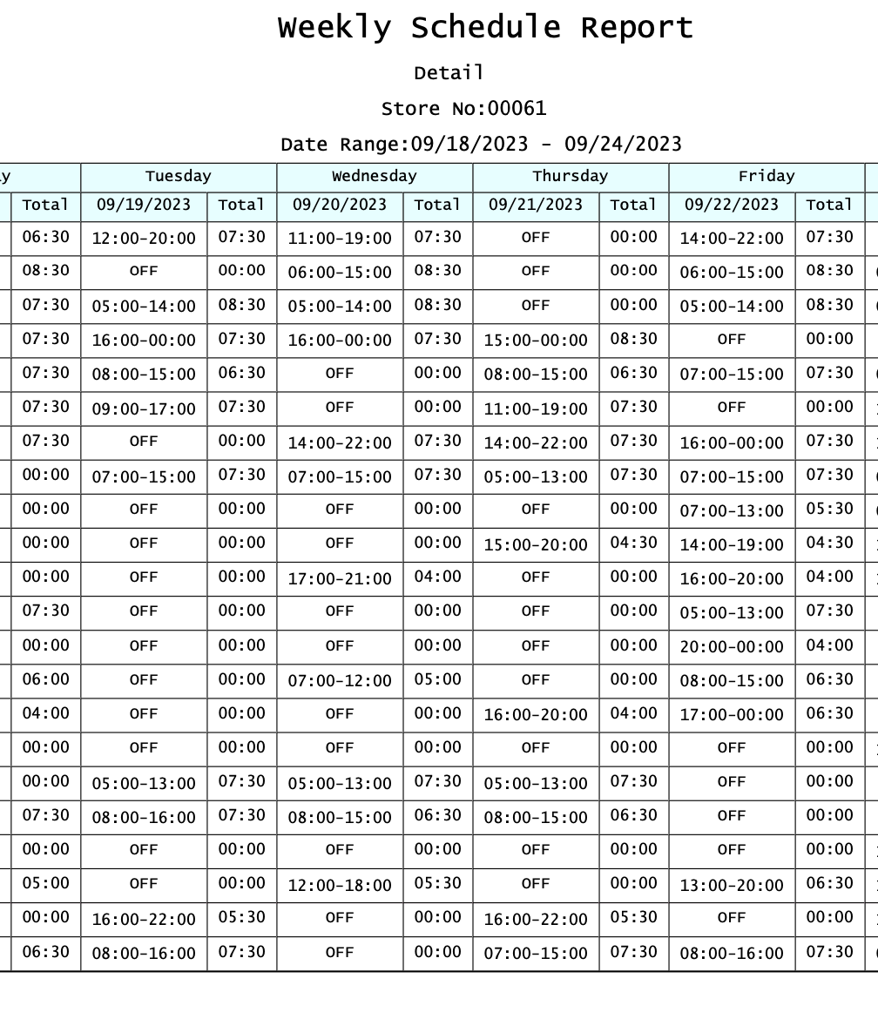
Your Schedule
Schedules are posted weekly in your Crew Room
Ask your manager for specific locations!
Scheduled hours are displayed in military time
Pro-tip: Take the time and subtract 12!
Ie; 14:00 = 14-12 = 2 = 2:00 PM
Schedules are private information – do not share on social media or with others for everyone’s safety!
  All changes must be approved by a manager!

Slide 51


Open-Door Policy
Speak up! | Work through your GM! | Contact your PEL!
If you are having an issue in your restaurant, or just aren’t sure about something, please speak up. We can’t help if we don’t know! | If you’re experiencing a problem, please work through your GM to reach a solution. If they do not respond or you are unable to work through them, please talk to your Supervisor. | We have a person dedicated to the employee experience for our organization. If you are unable to reach a resolution or if you have a question that is unanswered, please reach out to Taylor through Workplace, Hourwork, or email – taylor@muellermcd.com

Slide 52
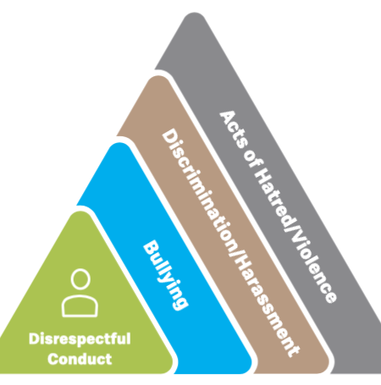
If you see something, say something!
Look out and listen for cues of a potential issue and provide support by:
-Stepping In
-Stepping Away
-Seeking Assistance
No matter what you choose, do not ignore! Small problems can lead to bigger issues.

Slide 53
Disciplinary Action Policy
1
2
3
4
Verbal Warning |  | Written Warning |  | Suspension |  | Termination
Your first infraction will result in a verbal warning. This may be documented just to confirm understanding and document that it took place. |  | Your next infraction will result in a written warning. |  | Your third infraction will result in a suspension. This suspension is unpaid. Length of suspension may vary based on infraction. |  | If the behavior continues after a suspension, the employee will be terminated.
The severity of the infraction may result in skipping one or more of these steps, especially in violation of our Zero Tolerance policies.

Slide 54
Agenda
Remember –
the employee handbook is available at all times in your restaurant or on our website.
It is your responsibility to ensure you understand these policies.

Slide 55
What Can You Expect

Slide 56

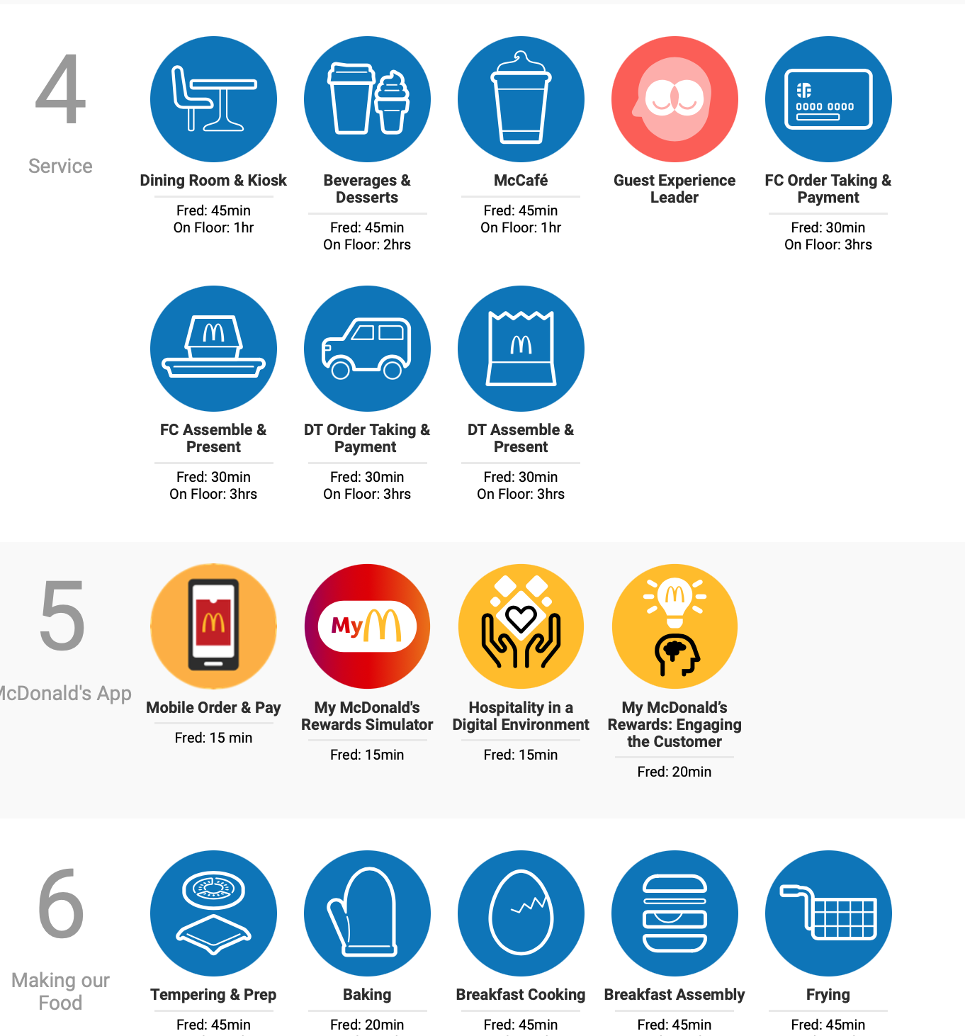
Your First Day
Report for your scheduled shift – your GM will contact you with your first day, so be sure to keep an eye on your email!
Turn in orientation packet materials with all signatures needed
Receive your uniform
Meet your trainer
Learn the ropes!

Slide 57
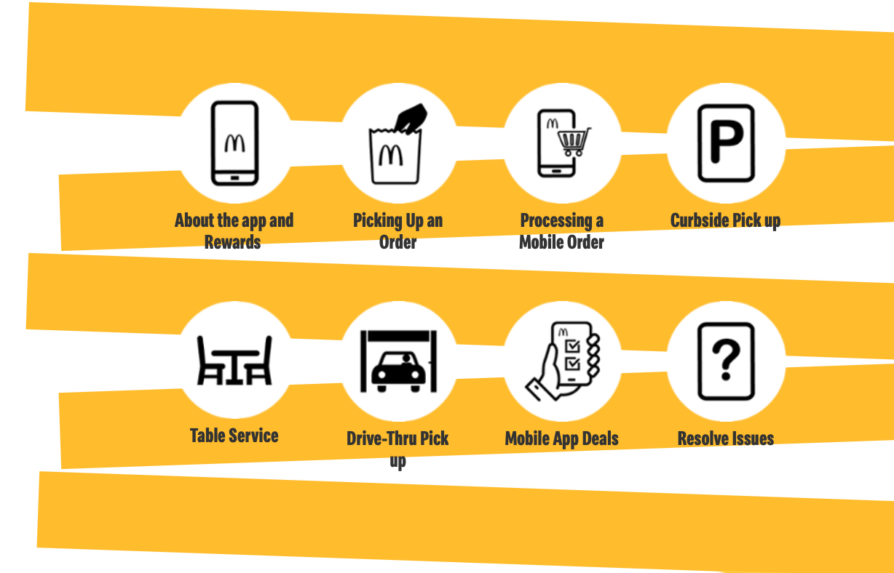
Days 2-30
Continue working with Crew Trainers and Managers to learn stations
Don’t get discouraged – before cross-training, you may need to master one station first!
Keep an open mind!
Ask questions!
Make friends!

Slide 58
Thank you for joining our team!

